Slide 1

Period of Instruction
Objects & Aims
Notes:
Welcome to the Period of Instruction. The basis of this presentation was prepared by the Ad hoc Special Committee on the Culture of Inclusiveness in P.E.O.

Slide 2
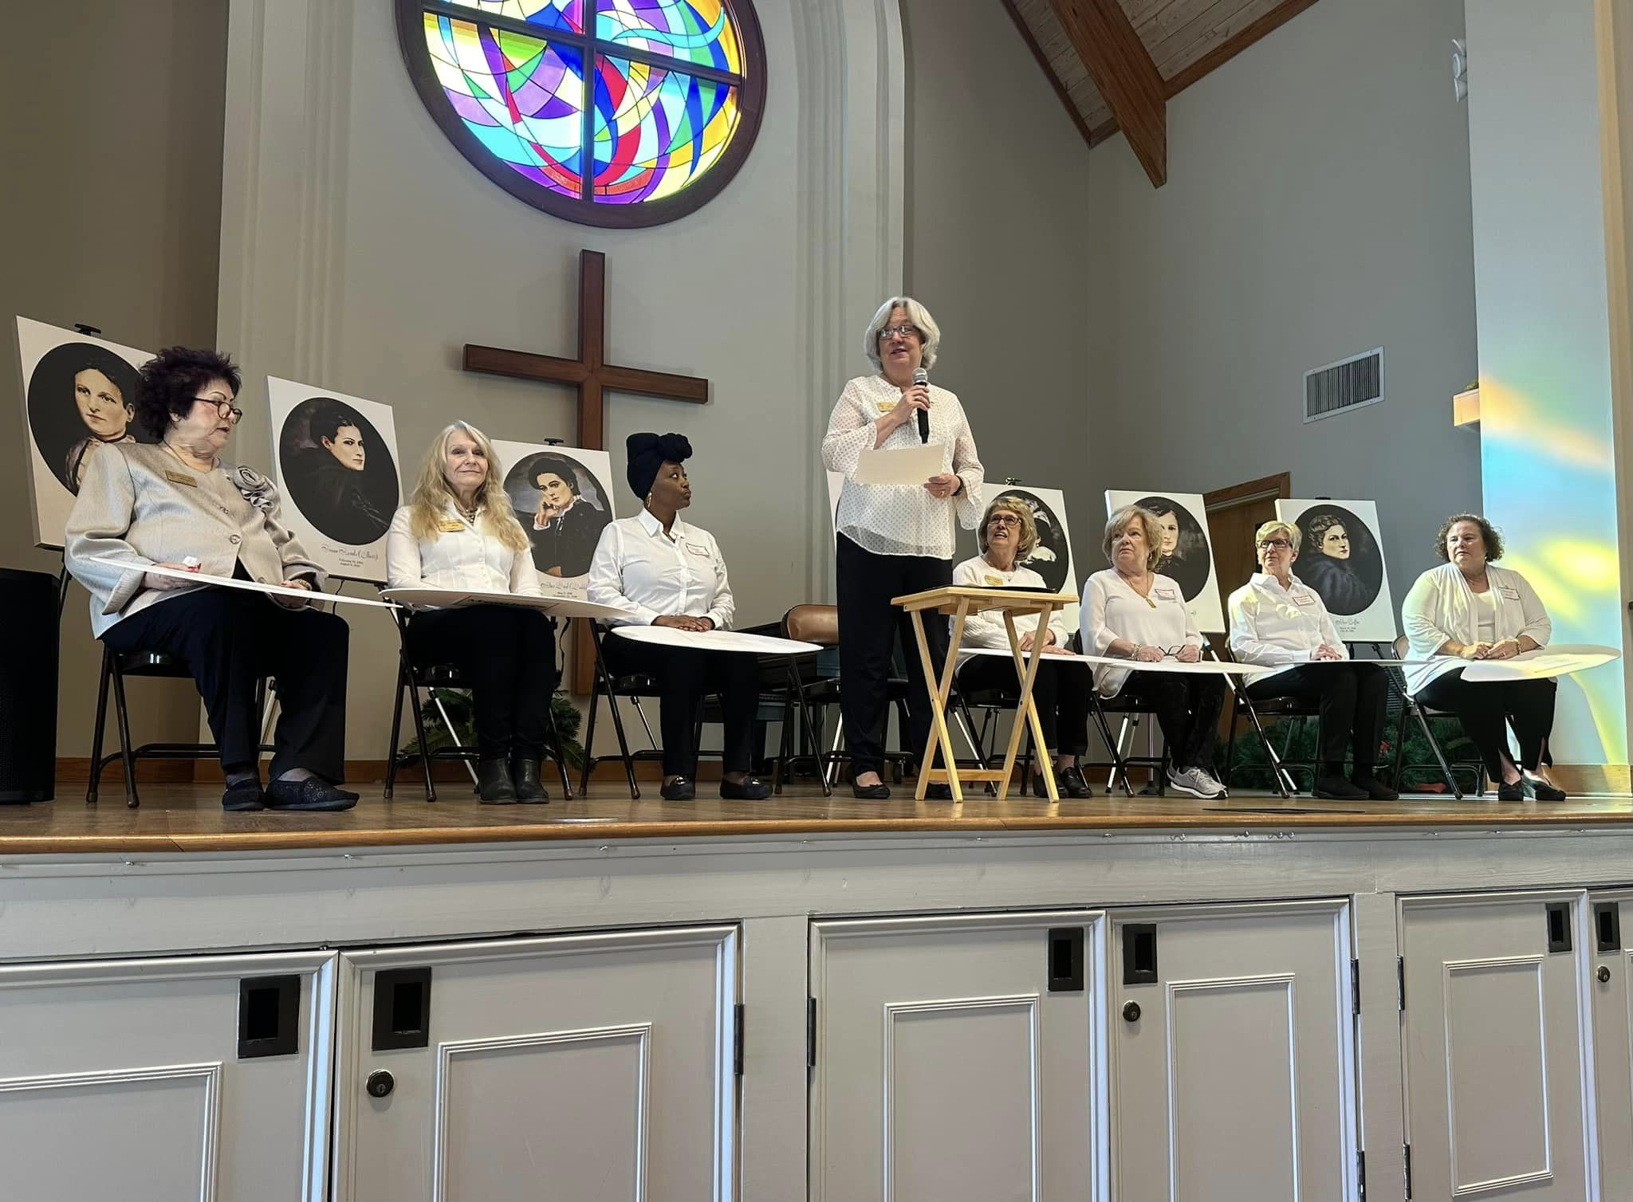
Notes:
P.E.O. began when a close group of friends was excluded from an invitation to join a collegiate sorority. These close friends felt so strongly that they belonged together they chose to create their own society. Each year we remember and celebrate our Founder’s, who as mere teenagers, set in writing our Objects & Aims which we continue to recite at every meeting. This practice has continued for 155 years and is intended for us to strive to meet these goals on a daily basis. By truly aligning our actions with the words we recite, we can make this world a better place for us all.

Slide 3
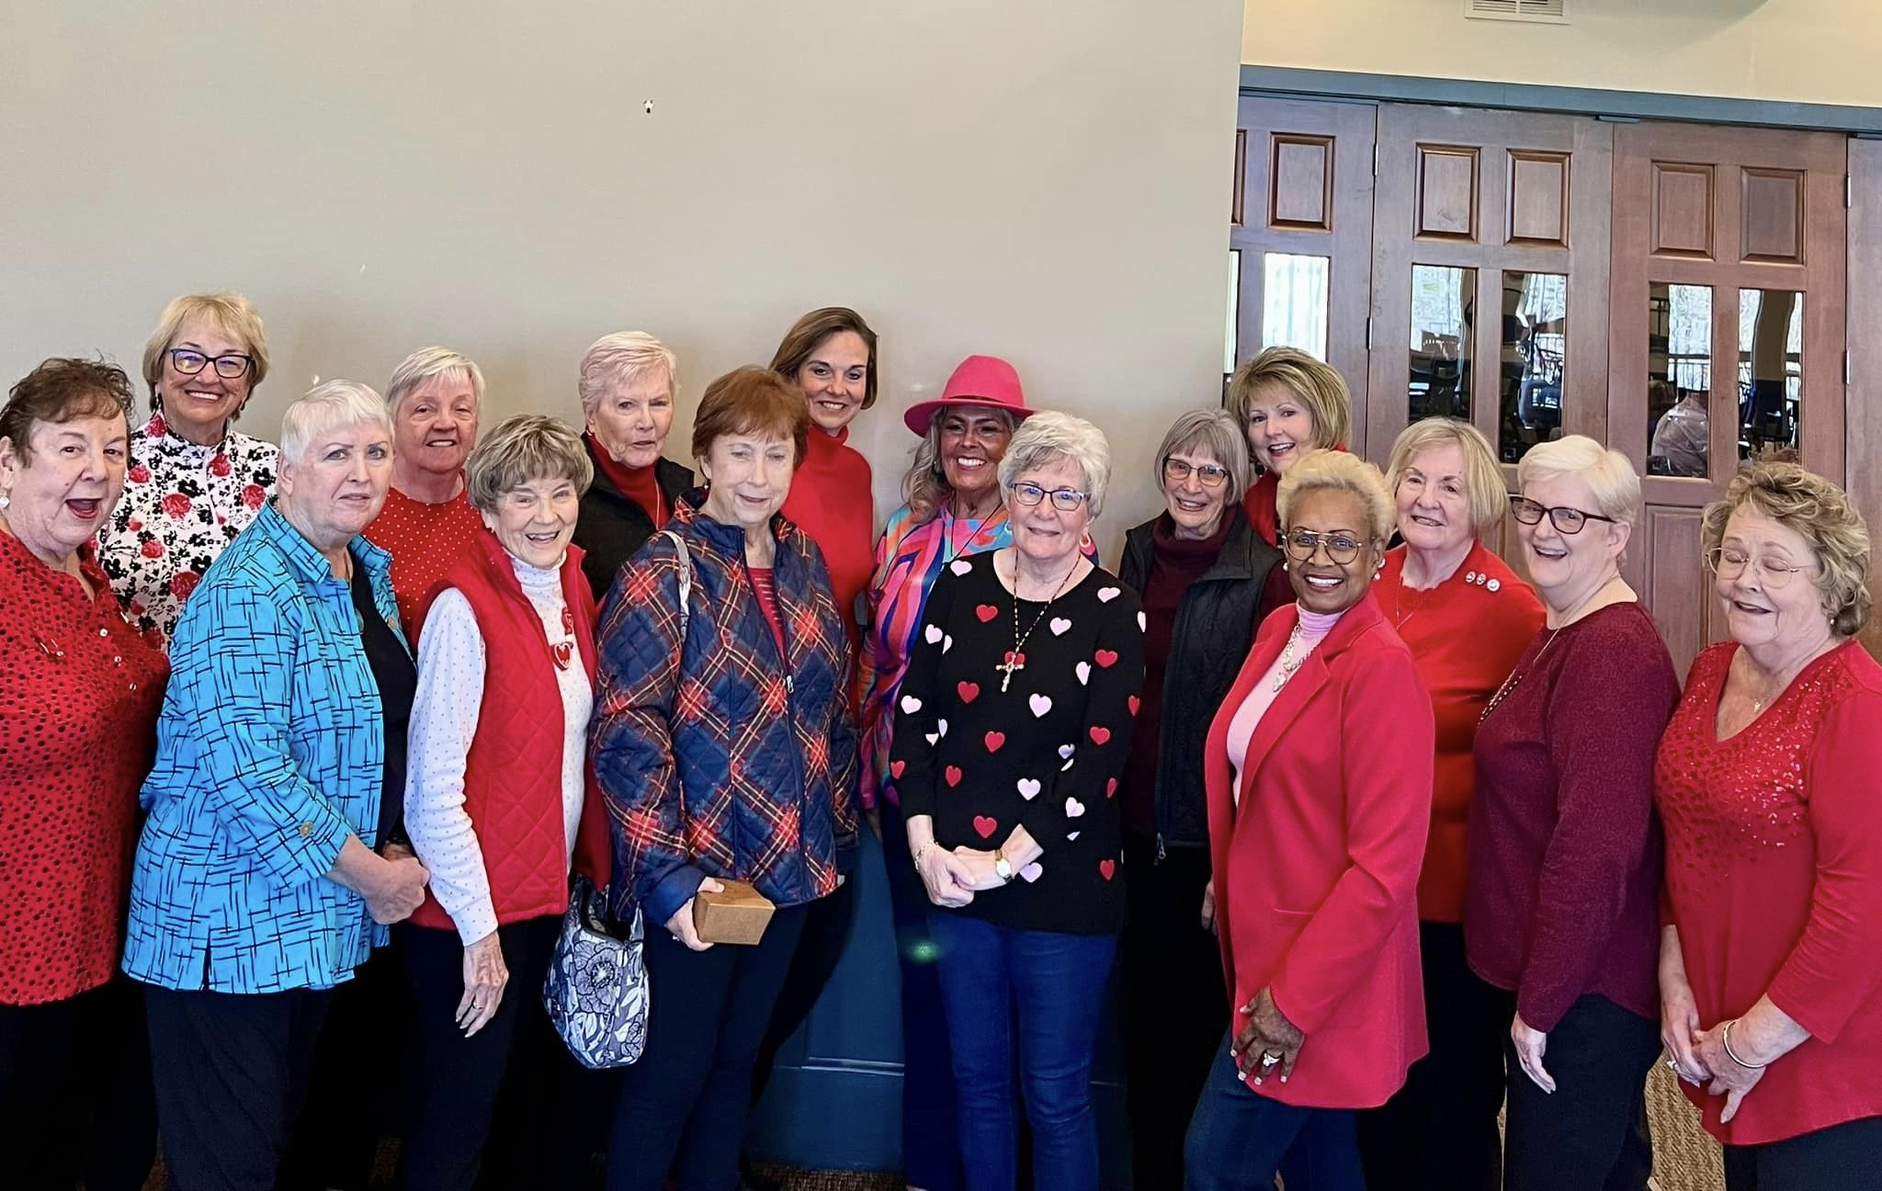
Belonging and Inclusiveness
Provide equal access
Ensure opportunities for those who may be excluded or marginalized
Guided by our Objects and Aims
Notes:
We as women have a universal need to belong to a group and feel accepted as part of the community. Having a sense of belonging leads to a higher level of engagement and passionate support. Everyone needs to feel loved and valued for their life experience, PEO experience, personal beliefs and their identity.
3

Slide 4

General Improvement
Notes:
The Objects & Aims of the sisterhood shall be general improvement. We believe general improvement implies that we wish to include all women who live by our values and virtues. We support the proposition that everyone is to be valued. There is room for us to create a space that is safe for all. Empowering others does not mean fewer rights for us. It is not a pie that has a finite number of pieces. The more we share our rights with others, the more we shall in turn, receive.
4

Slide 5
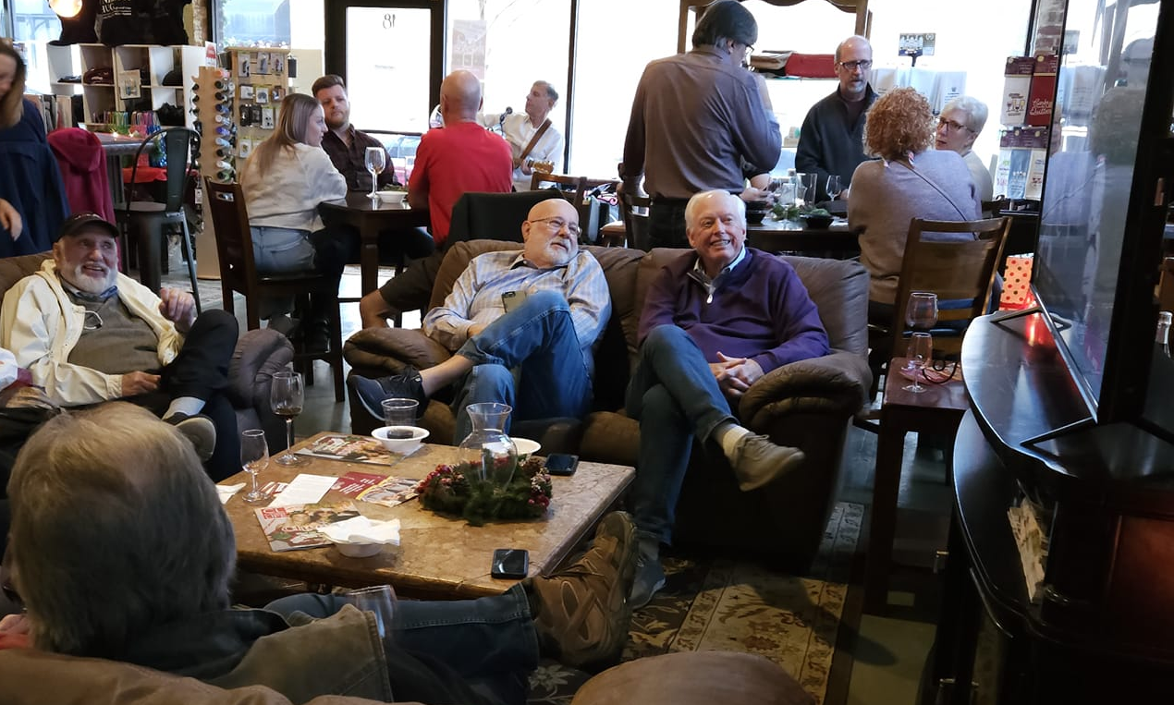
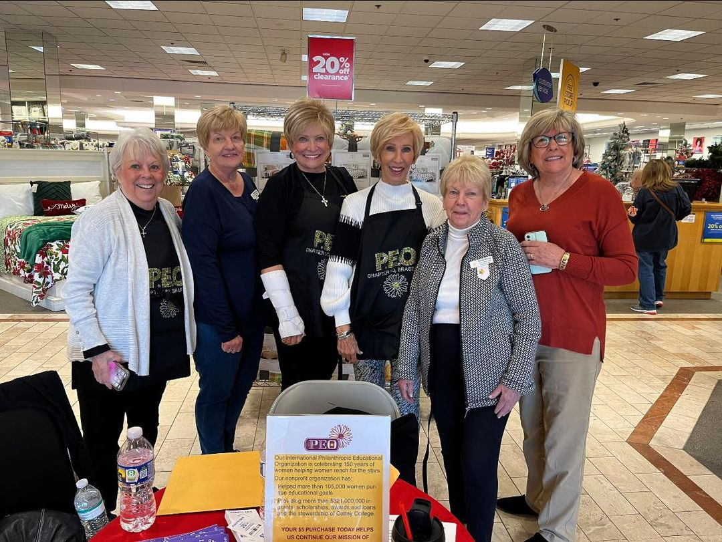
Growth in Charity
Express kindness for others
Enjoy getting to know one another through leisure and service activities
Ensure sisters feel welcome to attend with or without a guest; or to bring their life partner regardless of marital status or gender
Embrace this opportunity to grow
Notes:
Our Founders created their own society out of their love for one another and the desire to nurture their friendship. To continue this goal today, we need to create opportunities where members feel welcome to bring a life partner regardless of marital status, or gender. Be certain your single, divorced or widowed sisters feel welcome to attend without a guest. Choose a movie to attend as a group; work together in service to your community. Moving forward sometimes means doing things differently than things have been done in the past.
Embrace this opportunity to grow.
5

Slide 6
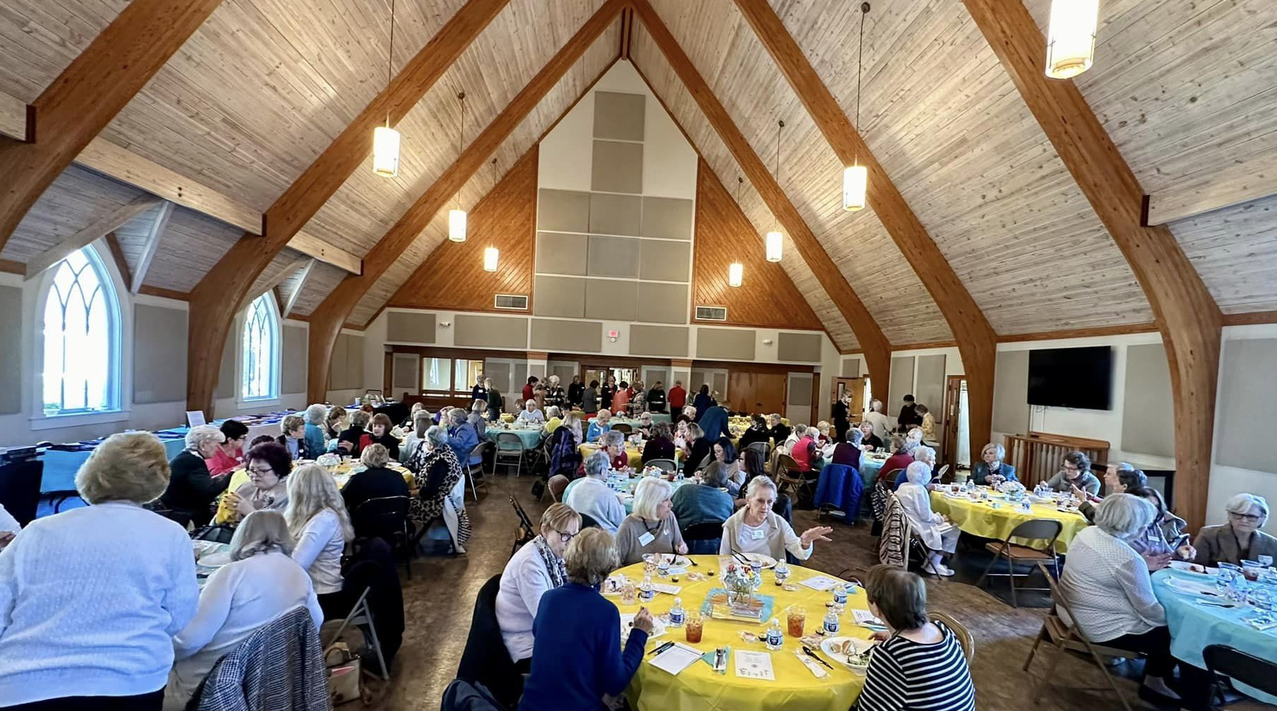
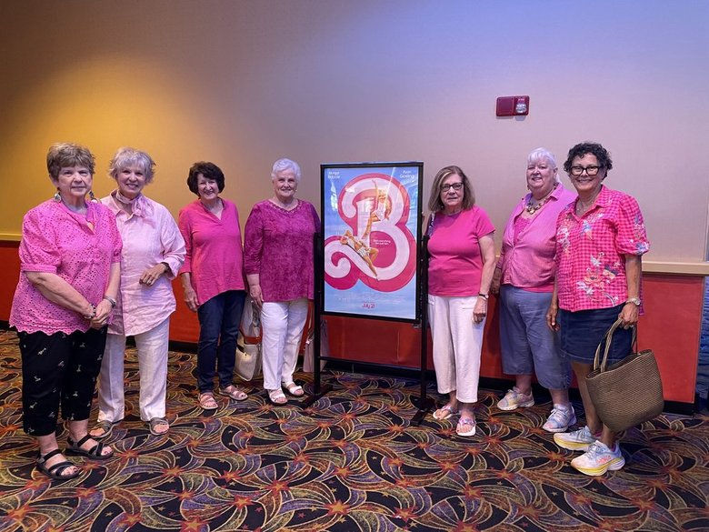
Growth in Knowledge and in Culture
Set intentional goals for your chapter
Strengthen the bonds of sisterhood through shared experiences
Learn about each other's life stories; embrace your differences
Plan programs/events to learn something new and embrace the opportunity to grow–together
Notes:
To energize our P.E.O. of the future, we must prioritize the “sisterhood” of our chapters, recognizing that participation comes when members are engaged, inspired, and connected to their chapter sisters. And one of the best ways to do that is to recognize and acknowledge them for who they are and what interests them. This can strengthen the bonds of sisterhood. Create opportunities for programs and events where members and potential members have an opportunity to learn new things together and about each other.
6

Slide 7
Nature
Botanical Garden
Art
Museum, Studio, Theater
Books
Library, Bookstore, Book Club
Study
Historic Site
Society
Podcasts, TED Talks, Lectures
Notes:
Plan a trip to the botanical gardens for experience nature; a museum, studio or theater to experience the arts; a trip to your local library or bookstore for a subject for your book club; a trip to a local historic site to enhance your knowledge or plan a gathering to listen to podcasts, TED Talks or lectures on the many issues facing our society today.
Embrace this opportunity to grow.

Slide 8
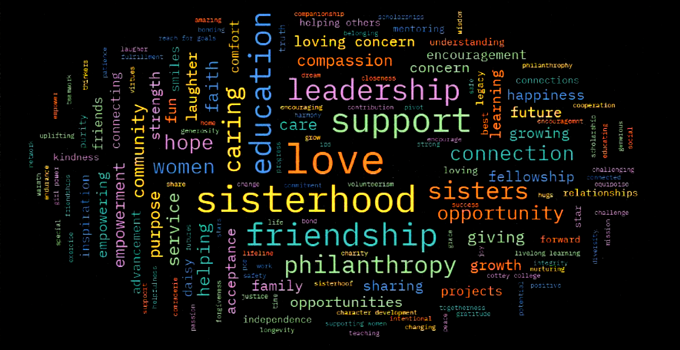
Radiate All Light Possible
Notes:
A single spark of a P.E.O.’s presence can light up a dark room to make everything visible. P.E.O.s radiate light and spread warmth in our world. For P.E.O. light is synonymous with knowledge, illumination, warmth, luster and radiance.
8

Slide 9
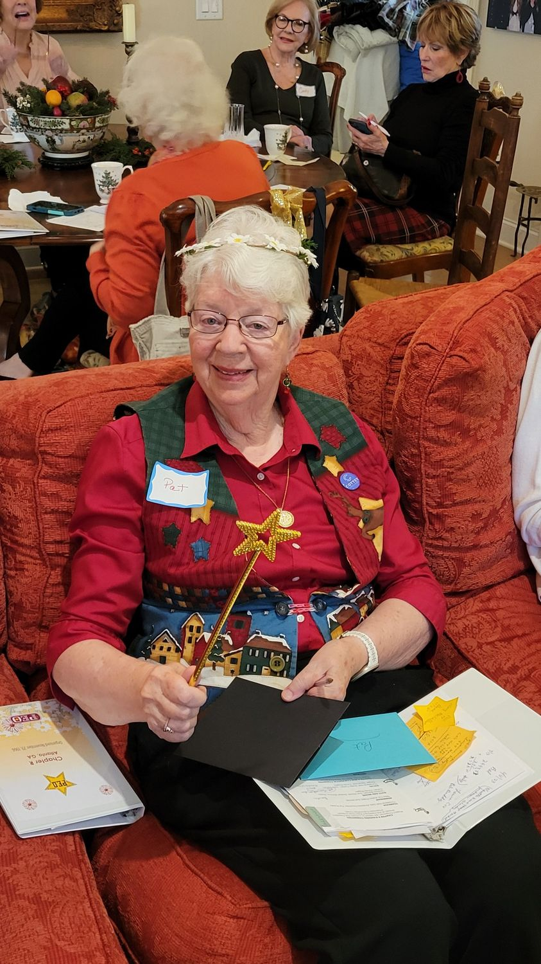
Equipoise and Symmetry
of Character
Be positive
Celebrate your sisters
Share your love of P.E.O.
Celebrate the advancement of all women
Motivate all women to set their goals high
Nurture your sisters and project candidates
Notes:
Equipoise can be defined as the balance of interests. Our chapters are full of incredible, intelligent and interesting women. Welcoming the plethora of ideas available to us through such women can enrich each of us and each of our chapters. Encourage active participation and discussion of ideas. Celebrate each other and your ideas. Celebrate the goodness in and the aspirations of your sisters. Share the power of love of P.E.O. with every member. Celebrate the advancement of all women, the sisters who are similar to you, and those who are different from you. Motivate all women to set their goals high, then nurture these women to be successful in reaching their goals.
9

Slide 10
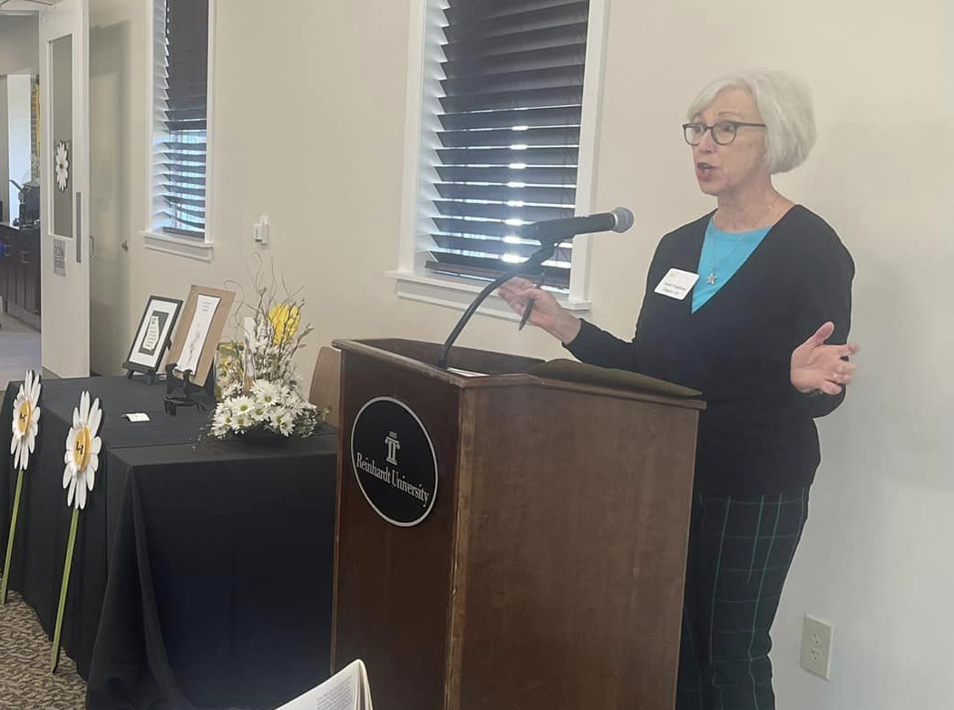






Temperance in Opinions, Speech and Habits
Notes:
True sisters don’t always agree, but they do always care about each other. Our Objects and Aims ask us to do the same with each and every member. Temperance in opinions, speech and habits should be thoughtfully considered before posting on social media platforms. When nurturing an inclusive culture within your P.E.O. chapter, keep in mind and be open to opinions which differ from your own.

Slide 11
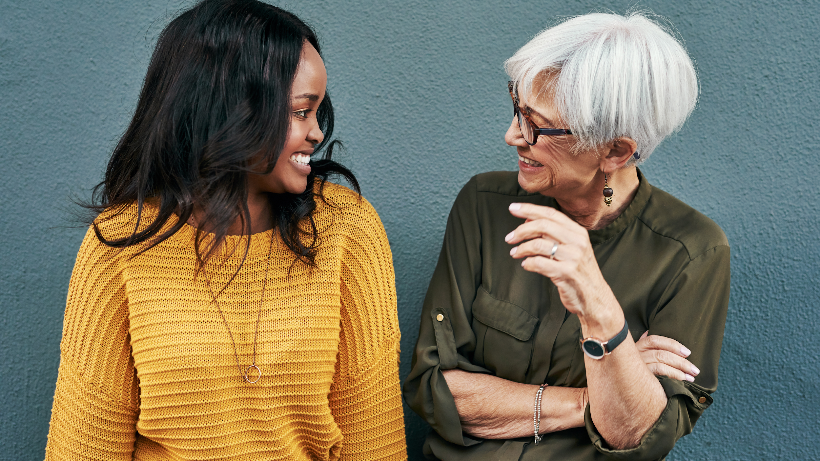
Full Import of P.E.O.
Empower all sisters, no matter their race, ethnicity, sexual orientation, nationality, socioeconomic status, religion and mental or physical ability
Notes:
We are passionate about our quest to inspire women to reach their highest aspirations. By being aware of the fact that your own experiences have impacted your opinions and created your own biases, empower others by taking the time to actively listen to them and be open to their experiences and opinions. Empowering each other comes from reaching out to our sisters and welcoming each one no matter their race, ethnicity, sexual orientation, nationality, socioeconomic status, religion and mental or physical ability. Seek to recognize and embrace the otherness in each other. We become positive influences in our communities by creating an inclusive culture within P.E.O. Our membership will continue to grow when diversity, equity and inclusion are recognized and embraced within our Sisterhood. We all will know, that we are supported in each task we undertake, and that we are cared for – that we matter to our sisters. The essential ingredient of P.E.O. is and has always been, our humanity with one another.
11

Slide 12
Our Influence in the Community
Diversity
Equity
Inclusion
Notes:
We become positive influences in our communities by creating an inclusive culture within P.E.O. Our membership will continue to grow when diversity, equity and inclusion are recognized and embraced within our Sisterhood. We all will know, that we are supported in each task we undertake, and that we are cared for – that we matter to our sisters.
The essential ingredient of P.E.O. is and has always been, our humanity with one another.
12

Slide 13

A Careful Consideration of Feeling
Notes:
When you send out letters, emails or speak at meetings, use a loving concern for every sister as you share your thoughts, concerns and opinions.
We do this because we are sincerely rooting for every sister’s success in life and in P.E.O. Through every action and interaction, make your chapter members feel cared for.
Remember that in all we do, what we say, and how we contribute, each shall be done with care, and a loving concern for each member.
13

Slide 14
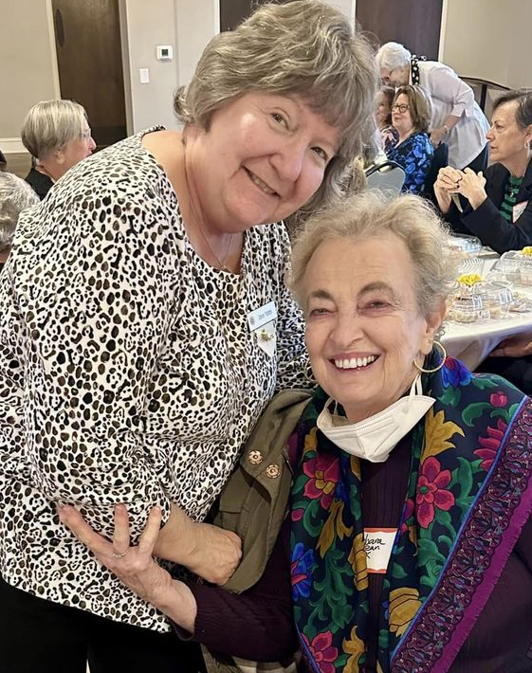
The Gift of P.E.O.
Welcome and accept others as their authentic and true selves.
Powerful outcomes
A Loving Concern for Each Sister
Notes:
Belonging is a sense that each of us is a valued and empowered member of a group. Whether your family introduced you to P.E.O., or a friend gave you the gift of P.E.O., our actions reflect who we are now, and what we will be in the future. Through our actions and tone of voice, we welcome and accept others as their authentic and true selves. Take the opportunity to reach out to your members who have not been able to attend meetings; offer a ride and restore their sense of belonging by bringing them to a meeting. As P.E.O. has proven time and time again, when P.E.O.s band together with a common goal, the outcome is powerful.
14

Slide 15
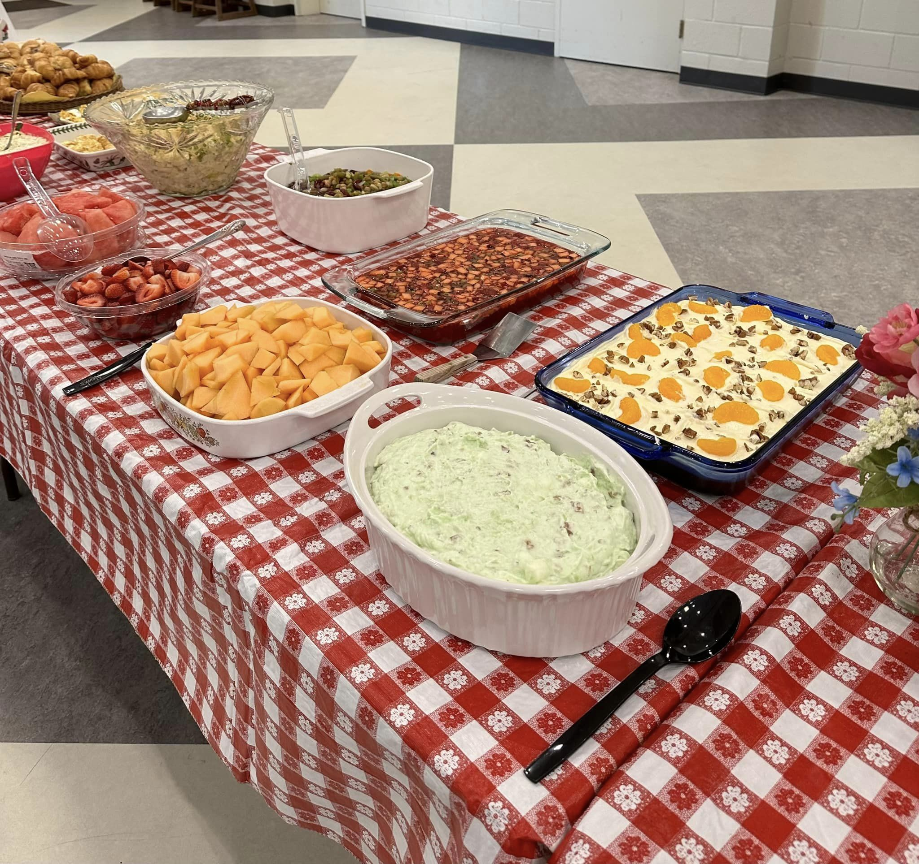
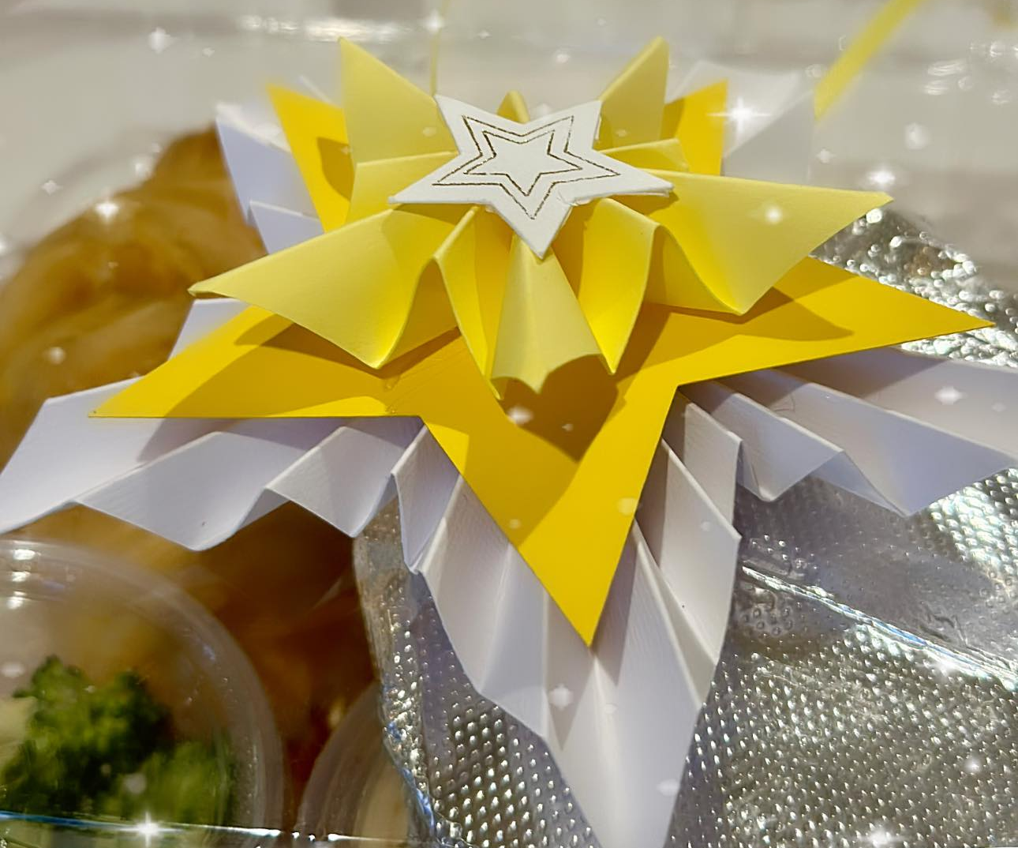
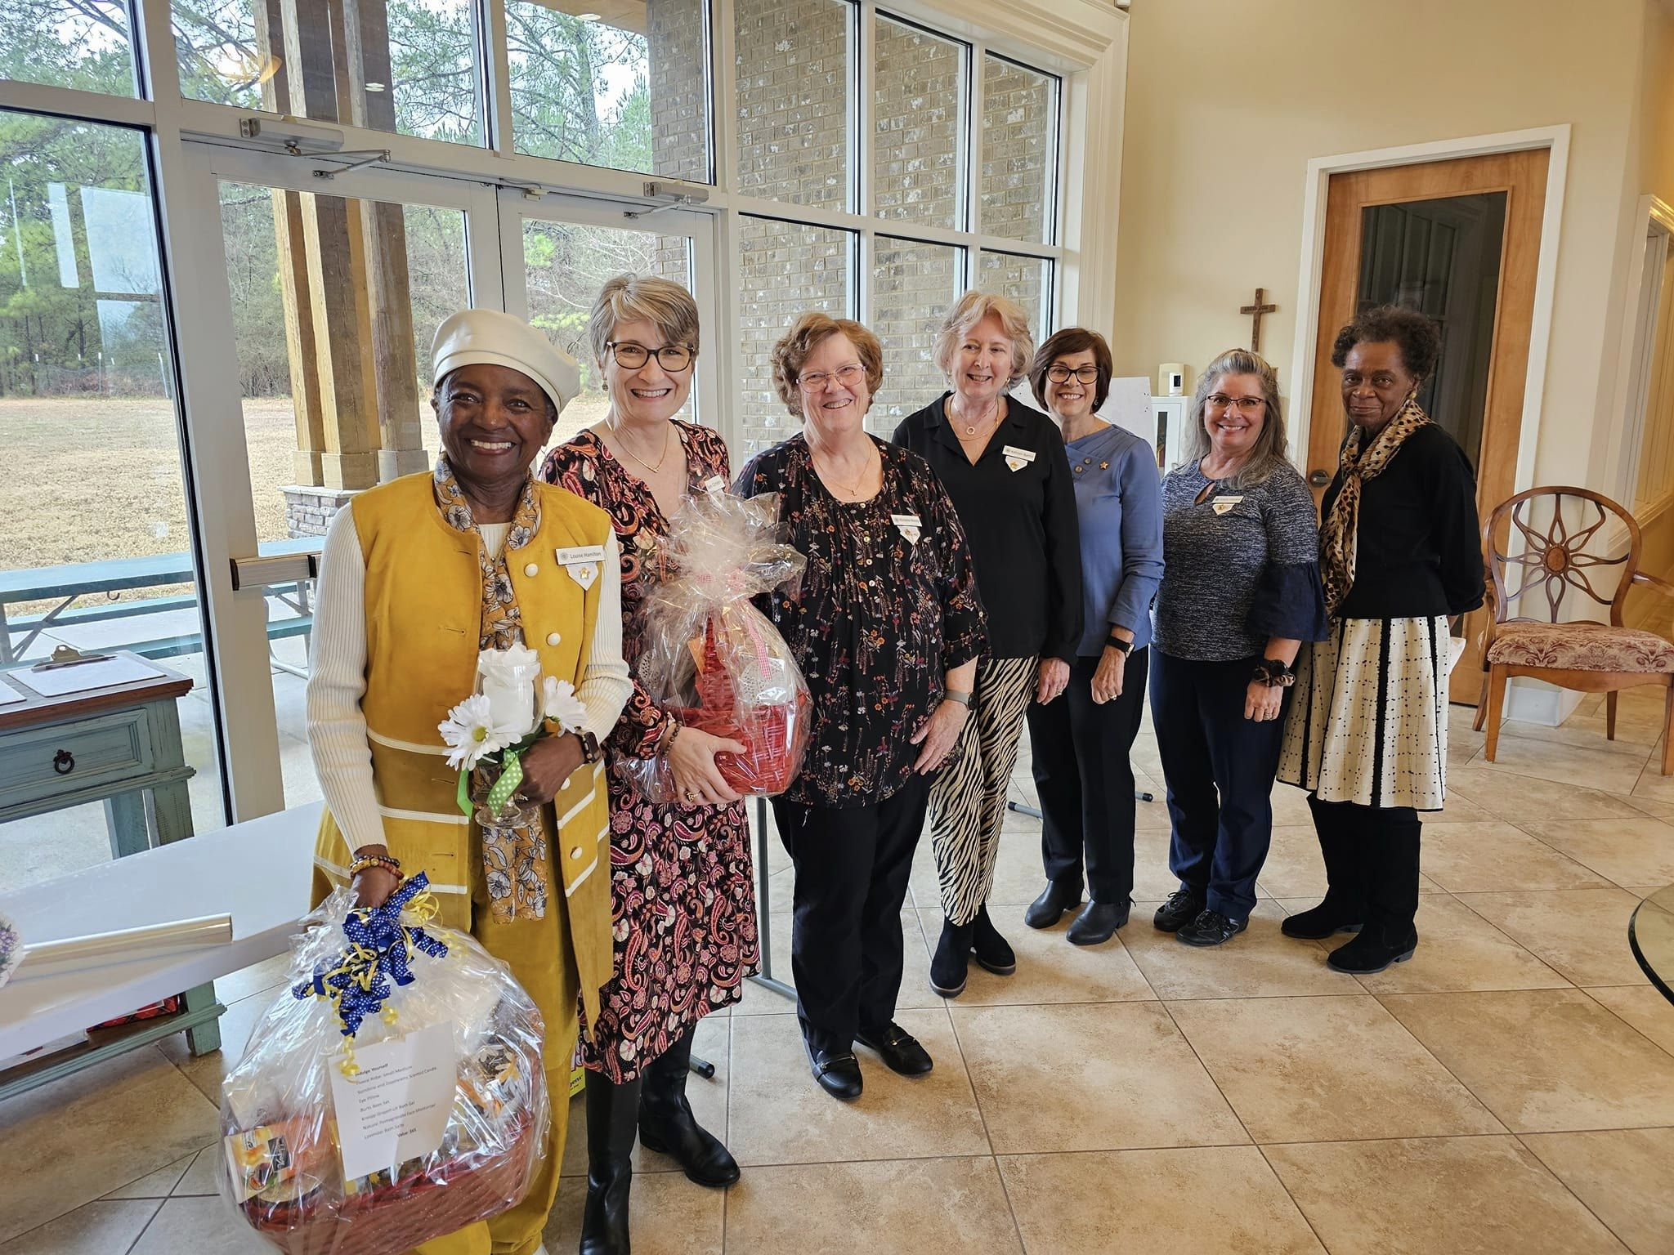
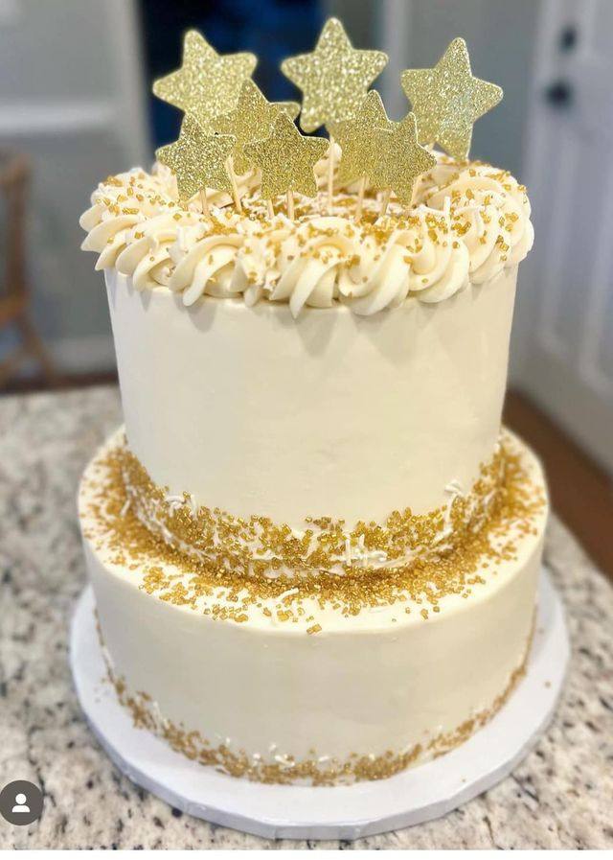
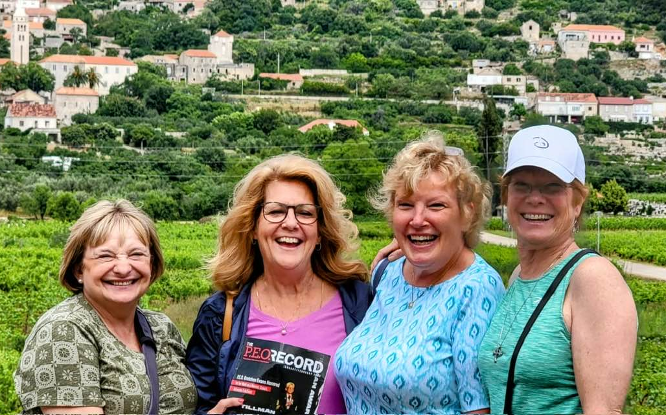

Celebrate
Our Sisterhood!
Notes:
Celebrate our sisters and our Sisterhood. Share your love of P.E.O. and seek growth in all you do!
15

Slide 16
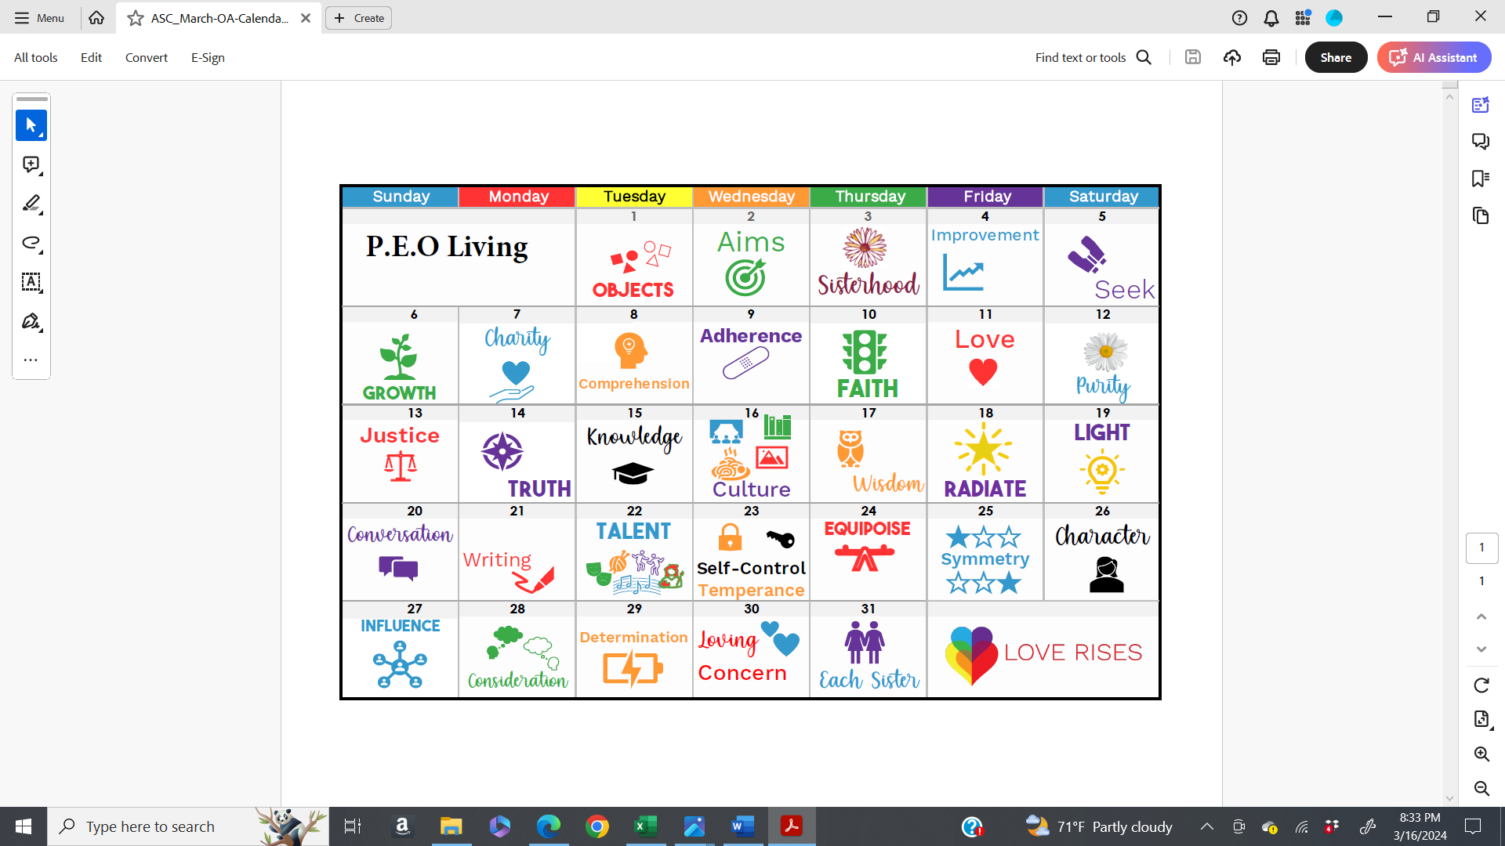
Notes:
At the beginning of each meeting we collectively recite the Objects & Aims of our Sisterhood; words and actions to which we have pledged ourselves to abide. The next time you recite them in a meeting or convention, take time to actively listen to the words and their meaning. I encourage you to take them to heart and choose to live by them each day.
16

Slide 17

Notes:
Thank you.

