Slide 1

Officer Training Workshop
President • Vice President • Treasurer • Recording Secretary • Corresponding Secretary • Guard • Chaplain
2025 Georgia P.E.O. Local Chapter Workshops

Slide 2
Websites Resources
www.peogeorgia.org
www.peointernational.org
To access the websites:
International: you will need your P.E.O. email (username) and the unique password you created. (must be updated every 120 days)
Georgia: you will use the current username and password for 2025
P.E.O. Constitution
GA State Bylaws and Standing Rules
List of Supplies for Officers of Local Chapters
Notes:
All of the information we will cover today lives in one of two places: International website or the GA website, with the majority of it being on the International website. The password on the International site is unique to you.The password on the Georgia site is valid for the entire calendar year.
I want to call out some specific documents that will be referenced the most.
Constitution can be found on the International website and lists the constitutional duties of each officer.
GA Bylaws can be found on the GA website and list duties of each officer as directed by Georgia P.E.O.
List of Supplies for Officers of Local Chapters is located on the International website.
Note: the passwords for both website are the same and change every year on January 1st. If you do not know the password, ask your president. If you ARE the president, ask your Board Buddy.

Slide 3
Instructions to Officers of Local Chapters IOLC
Notes:
Let’s talk about the most important resource: Instructions to Officers of Local chapters, fondly known as the IOLC.
If there is nothing else you remember today, please remember these 4 letters.
The most recent version was updated September 2024.
The complete IOLC contains sections for each officer. The president shall print this document in its entirety and keep it in her President’s book. Every other officer should review the section specific to her office. Review this document thoroughly and often! 90% of the questions we get asked as state officers can be found in the IOLC.

Slide 4
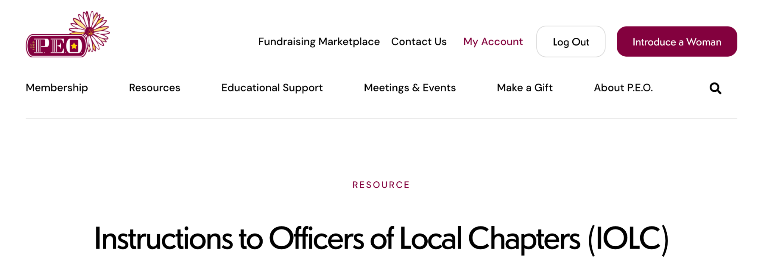
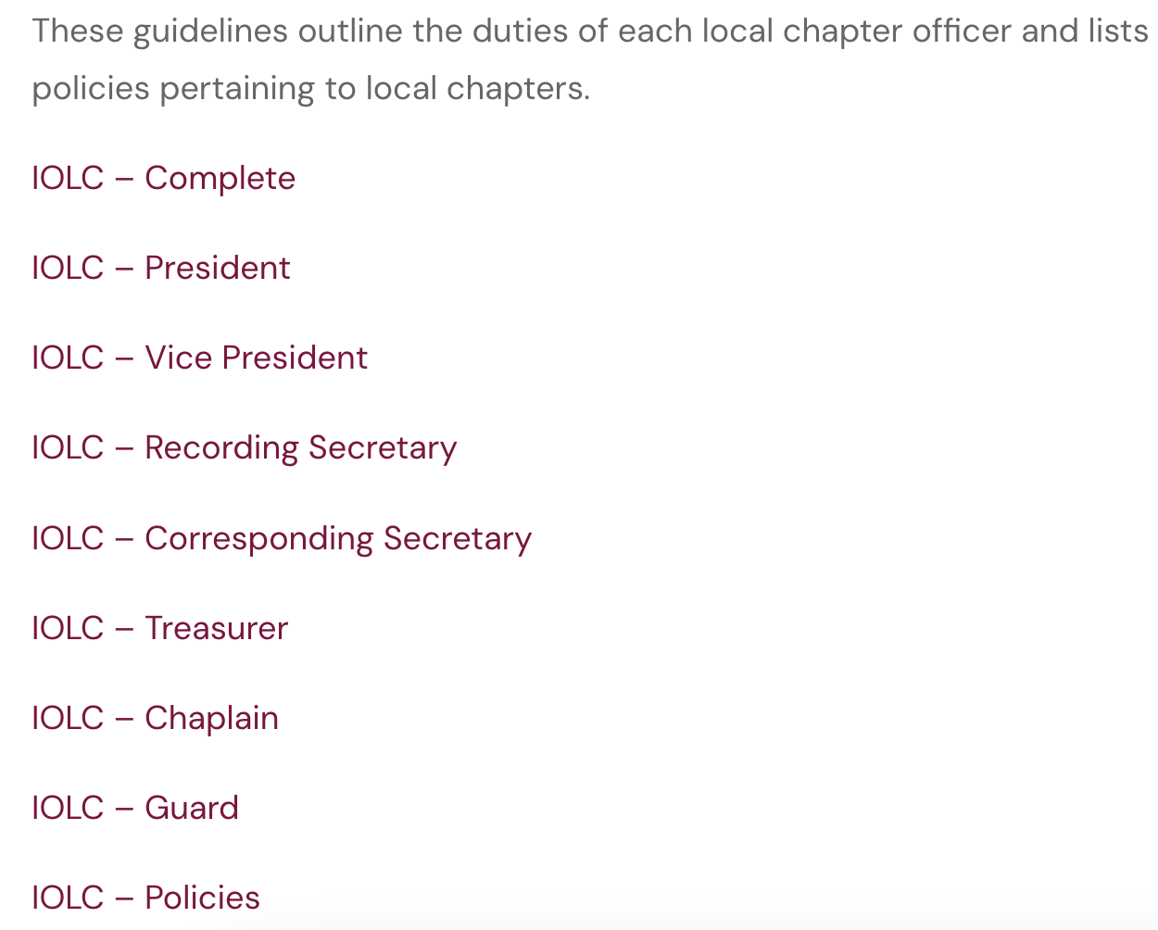
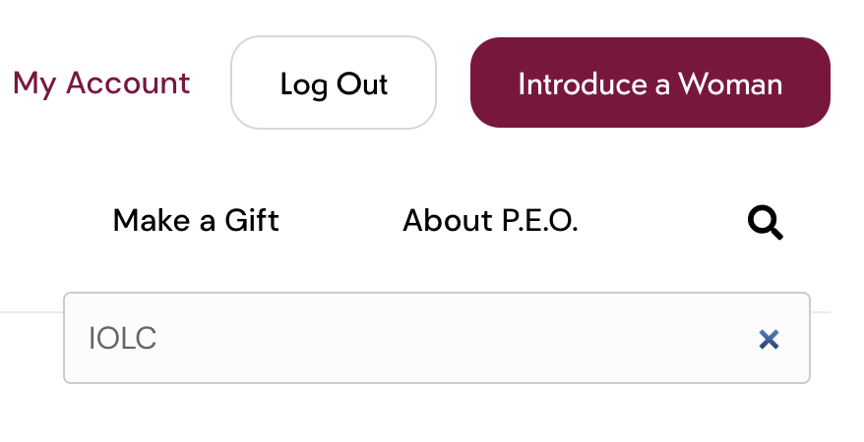
Instructions to Officers of
Local Chapters
Login to www.peointernational.org
Select Resources
Search Instructions to Officer of Local Chapters (IOLC)
Click on your Office
Shortcut:
type “IOLC” in the search box
Notes:
Let’s take a look at where to find the IOLC…
The IOLC may be found on the international website under Resources. By the magnifying glass, search “IOLC”. Select Instructions to Officers of Local Chapters and locate your specific office. If you are serving as Vice President, Guard or Chaplain, you may find the entire IOLC listed as “IOLC - Complete” at the top of the list. Note that the IOLC includes guidelines for the specific offices AND the policies to which we must all adhere. All officers should become familiar with the policies included in the IOLC
Note: International is frequently making updates. You should check periodically for new information. For the most recent updates, click resources>resource library. The most recent updates will typically appear on page one and page two.

Slide 5

Guard

Slide 6

Conduct a visual verification of membership prior to the start of the meeting.
Should a P.E.O. guest attend your meeting, the Guard may request a membership card to verify active status.
No longer required:
Stating “Madam president all who are present are entitled to remain” is no longer required.
Password is no longer taken/given verbally prior to a meeting.
Notes:
The guard’s first responsibility is to Conduct a visual verification of membership prior to the start of the meeting.
After the 2021 CIC amendments the following are no longer required:
Stating “Madam president all who are present are entitled to remain” is no longer required. This wording has been removed from the president’s book.
The password is no longer taken/given verbally prior to a meeting.

Slide 7
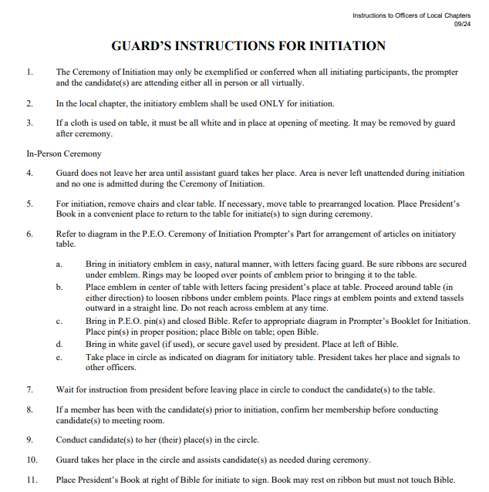
Ceremony of Initiation
The Guard sets the tone for the
initiation ceremony.
Setting the table should be deliberate
and thoughtful.
Notes:
One of the most important responsibilities of the Guard is her role during a Ceremony of Initiation. Did you know there are very specific instructions for the guard in the Ceremony of Initiation? There are 13 steps for an in person initiation and 5 steps for a virtual ceremony. Guess where you can find those instructions? IOLC!
It is important for all guards to read the instructions in their entirety.
Presidents, it is important that you also review these instructions and practice with your guard prior to initiation.

Slide 8

Chaplain

Slide 9
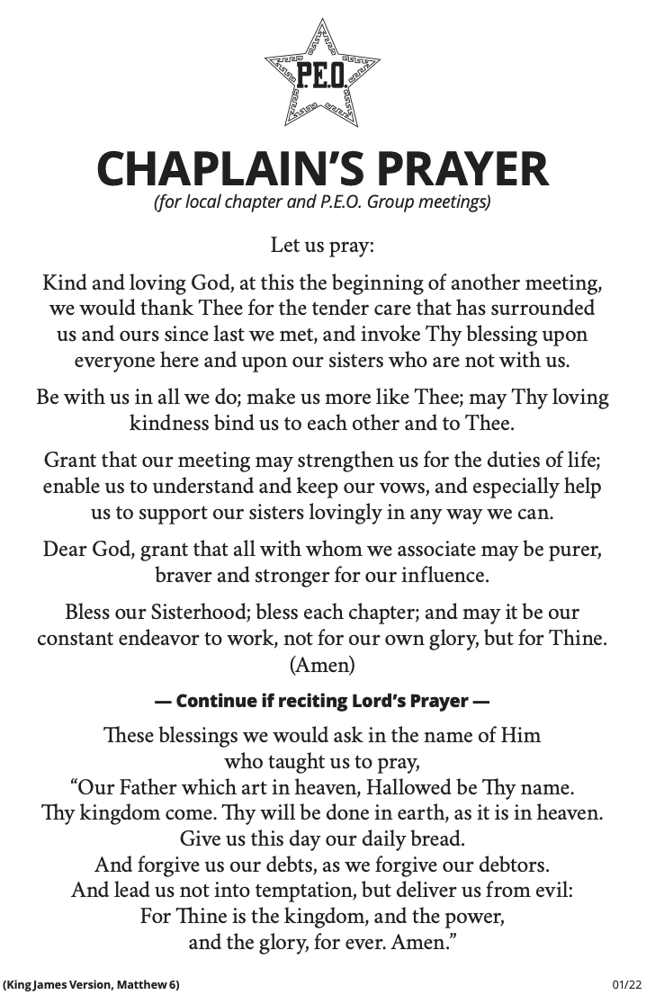
Conduct the devotions of each meeting.
Recent changes include:
Bible or other devotional text is acceptable
Lord’s Prayer is optional for the chapter (decided by chapter)
Chaplain’s Prayer wording updated 1/22
Notes:
The chaplain’s responsibility is to conduct the devotion of each meeting. Some recent changes include:
The Bible or other devotional text is acceptable; not just the Bible
Lord’s Prayer is optional for the chapter (decided by chapter)
The Chaplain’s Prayer wording was updated on 1/22, so please be sure you have the most updated version.

Slide 10

Recording Secretary

Slide 11

Take minutes!
Record what was done at the meeting – not what was said
Record just the facts, neutrally, without reflecting your personal opinion on any chapter decisions.
Remember:
If provided for in the local chapter bylaws, the recording secretary shall distribute a draft of the meeting minutes reviewed by the president to all chapter members by email or postal service before the next regular or special meeting.
Notes:
The Recording Secretary’s job is to take the minutes of each meeting and special meeting.
Record what was done at the meeting – not what was said. Record just the facts, neutrally, without reflecting your personal opinion on any chapter decisions.
As of the 2023 CIC Note: It is optional for the local chapter to allow distribution of draft minutes. The procedure to allow the distribution of the draft minutes is for the local chapter to propose an amendment to the local chapter bylaws, vote on the amendment favorably and include the wording in their bylaws. The secretary first sends a draft to the president to review and approve before they are sent to the rest of the chapter.

Slide 12
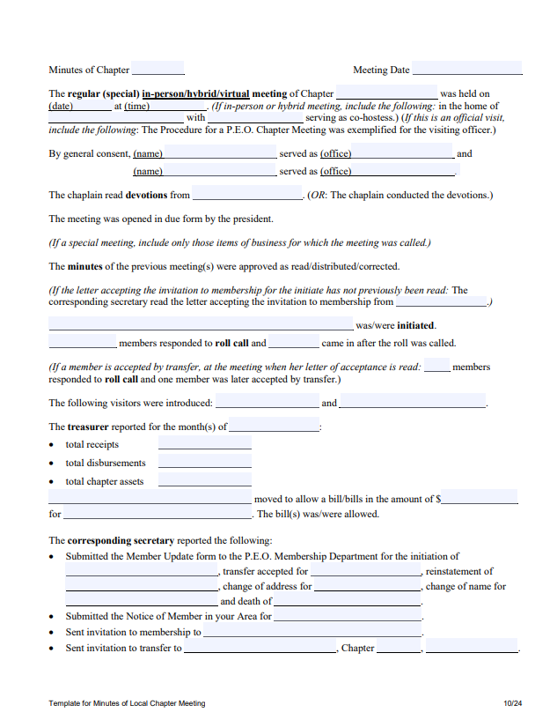
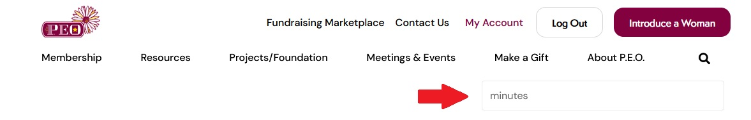
Recording Secretary Documents
Template for Minutes of Local Chapter Meeting (10/24)
Instructions for Taking Minutes
Notes:
There is a minutes template located on the International website. At magnifying glass search for “minutes template” and select “template for minutes of local chapter meeting.”
Within the Recording Secretary IOLC you will also find Instructions for taking minutes.

Slide 13

Corresponding Secretary

Slide 14
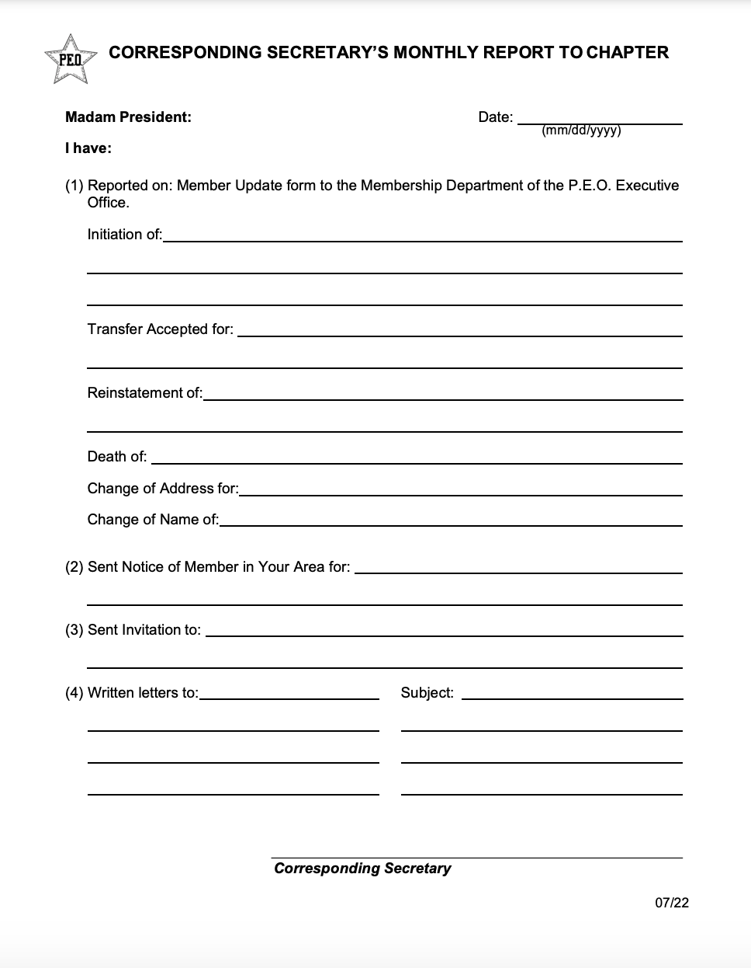
Give a monthly report.
Correspondence can be summarized except when noted that it must be read in its entirety.
If no correspondence was sent, the report is “No correspondence was sent.”
If no correspondence was received, the report is “No correspondence was received.”
Notes:
It is the Corresponding Secretary's duty to give a monthly report of all correspondence received and all correspondence sent at each meeting. A template for the report can be found on the International website under Resource Library > Local Chapter Officers > Corresponding Secretary.
Correspondence can be summarized except when noted that it must be read in its entirety.
If no correspondence was sent, the report is “No correspondence was sent.”
If no correspondence was received, the report is “No correspondence was received.”
It is customary to read the correspondence in order of International, State, Local.

Slide 15
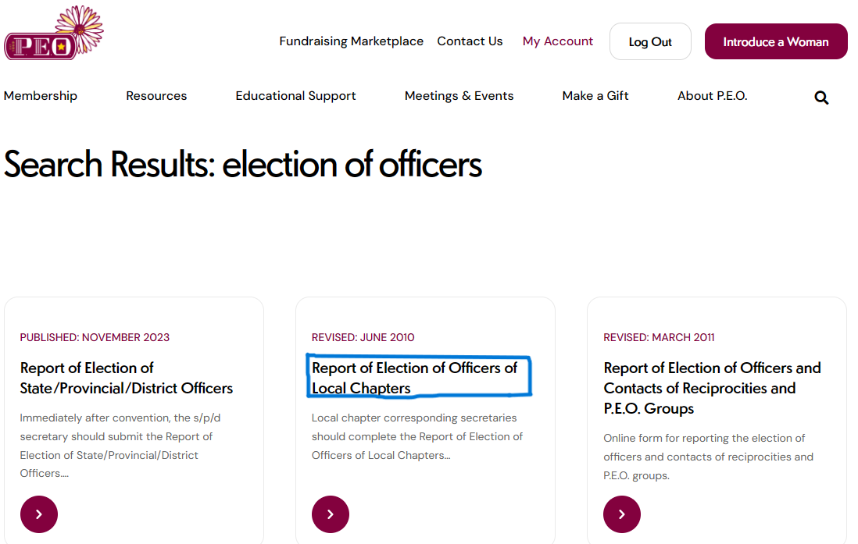
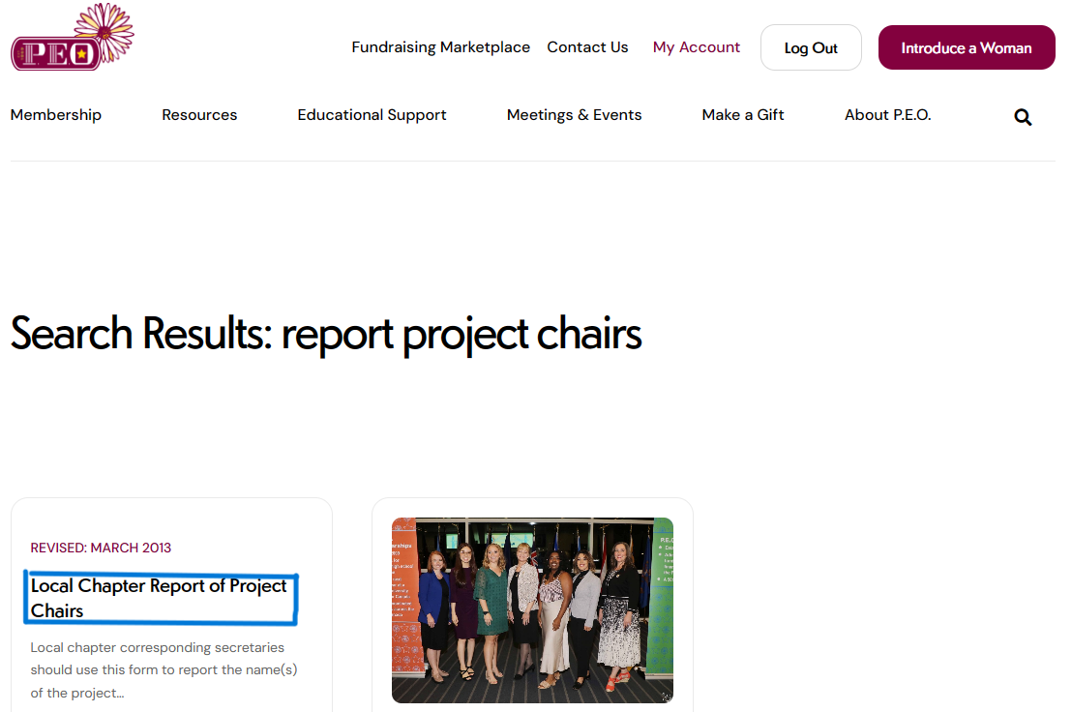
Report names of:
In March: Elected local chapter officers
In March: Elected GA convention delegates (2) & alternates (2)
In March: Nominees for delegates & alternates of International Convention (in odd years)
As Soon as Appointed: Assigned Project Chairs
Note: If officer/chair is serving a second year, entry is still required.
Notes:
It is the Corresponding Secretary’s responsibility to let International know ‘who’s who’ in your chapter. This includes Officers, Delegates, Alternates, and Project Chairs. All of these positions can be reported on the international website under Resources > Search for “Report of Elections” > Scroll down to “Report of Election of Officers of Local Chapters”. Search for “Report of Project Chairs” > Scroll down to “Report of Project Chairs”.
Report of Election of Officers of Local Chapter should be reported immediately following your March meeting. The Project Chairs should be reported as soon as appointed.
If officer/chair is serving a second year, entry is still required. If you do not update the officer or chair even if it is with the same name, the system will flag it and notify us that it is still showing last year’s officers and chairs.
Ex: If Claire Hetherington served as the Membership Chair last year, and will be continuing on for a second year, you still need to go into the system and select Claire’s name and submit the update.

Slide 16
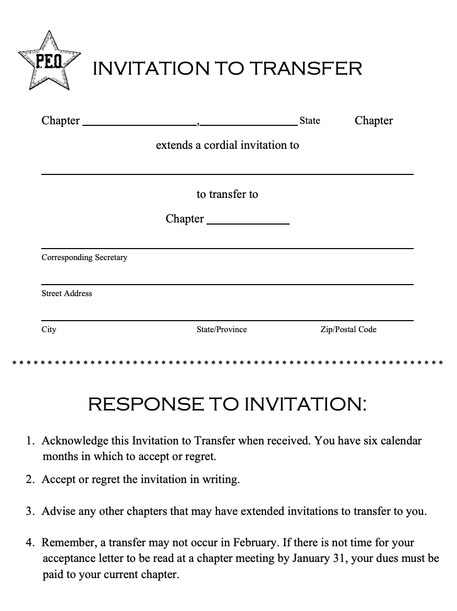
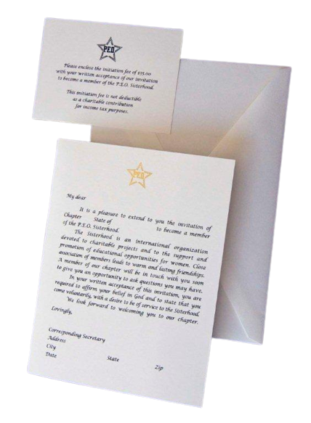
Send/receive invitation to Membership and Invitation to Transfer. Web version (2/25)
Note: No transfers in February but you can initiate in February!
If a member is initiated in February, she will need to pay the $35 initiation fee for that year in addition to next year’s dues.
Notes:
After a pro vote is taken during a meeting to invite someone to join or transfer to your chapter, it is your job to invite them!
If a member is initiated in February, they will need to pay the $35 initiation fee for that year in addition to next year’s dues.
Note: No transfers in February but you can initiate in February! This means no motions to extend invitation and no acceptance of a transfer in that month.

Slide 17
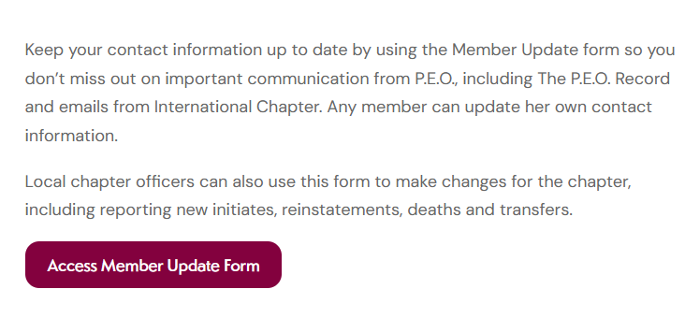
Use “Member Update Form”
to report:
Changes in contact information
Initiations
Transfers
Reinstatements
Deaths
A member can only go inactive by not paying dues by Feb. 28/29. This is reported as part of the annual reports.
Notes:
If there is any change in anyone’s status or contact information, it is the responsibility of the Corresponding Secretary to let International know. International does not know if someone joined P.E.O., if someone entered Chapter Eternal or if someone got a new email address unless you tell them.
A member does have the ability to update her own contact information, so you may want to check with her to see if she has already done it, or if she’d like help doing it.
The only place you report inactive status is on the Annual Report. The last day in February is the only day a person can go inactive.
To access the Membership Update Form, log onto the international website > under membership > “manage membership” > scroll down to [access member update form] button

Slide 18

Treasurer

Slide 19

Call the roll at each meeting.
A new roll is made in March
Templates are available online and can be filled in electronically or by hand
(rev 2/25)
List names of active members in alphabetical order
Leave space for adding names of new members
Ex: “Madam president, there are 17 members responding to roll call, and 2 visitors.”
Pro Tip: Indicate presence of sister with sequential numbering so you will have your total at the end (EX: Laverne Cox = 1, Cathy Truett = 2, Jennifer Lopez = 3)
Laverne Cox 1
Jennifer Lopez 2
Cathy Truett 3
Notes:
It is the responsibility of the Treasurer to call roll at each meeting.
A new roll is made in March
Templates are available online and can be filled in electronically or by hand
List names of active members in alphabetical order
Leave space for adding names of new members
The treasurer reports, “Madam president, there are 17 members responding to roll call, and 2 visitors.” A visitor is anyone who is a P.E.O. who is not in your chapter.
Pro Tip: Instead of using check marks or X’s, indicate presence of sister with sequential numbering so you will have your total at the end (For example: Jenn Lopez = 1, Cathy Truett = 2, Laverne Cox = 3)

Slide 20
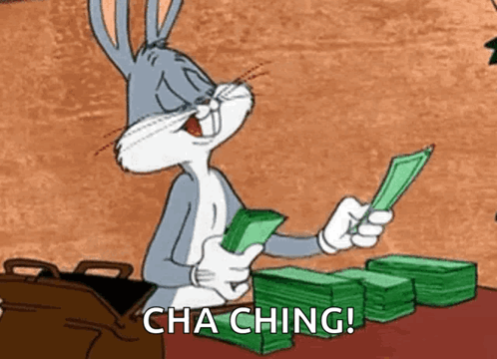
Deposit all money into chapter bank account.
All disbursements must be approved by chapter vote prior to payment, including budget items.
Notes:
It is the responsibility of the Treasurer to deposit all money into the chapter bank account.
All disbursements must be approved by chapter vote prior to payment, including budgeted items.

Slide 21
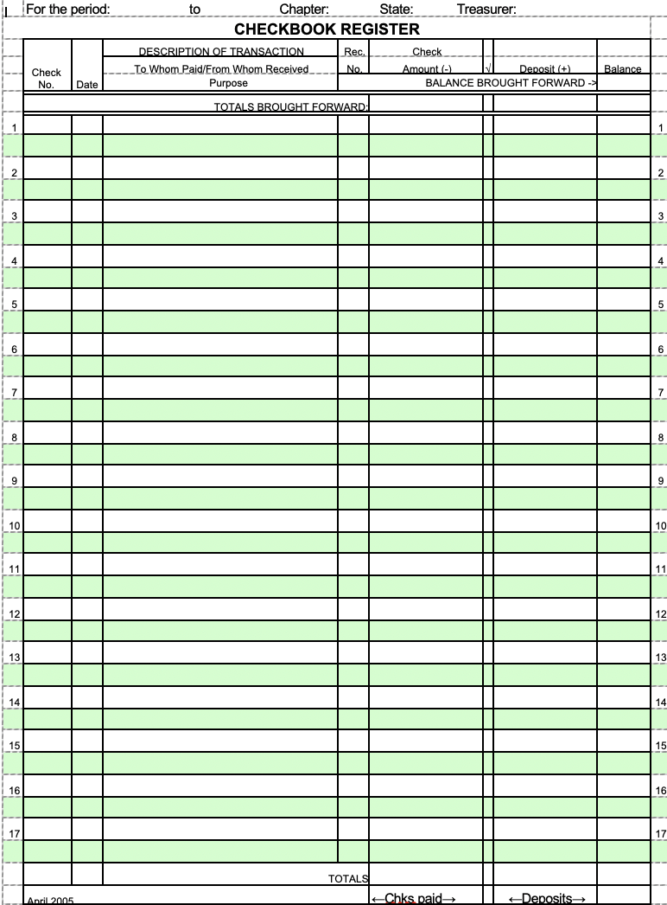
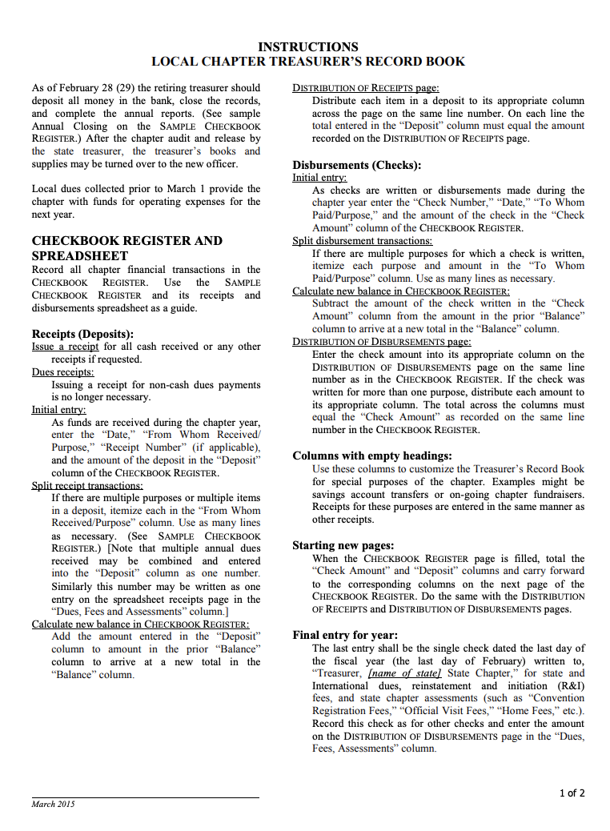
Record all chapter financial transactions in the Checkbook Register .
Use the “Instructions for Local Chapter Treasurer Record Book” for guidance.
Notes:
It is the Treasurer’s responsibility to record all money coming in and out of the chapter in the Checkbook Register. Use the “Instructions for Local Chapter Treasurer Record Book” for guidance.

Slide 22
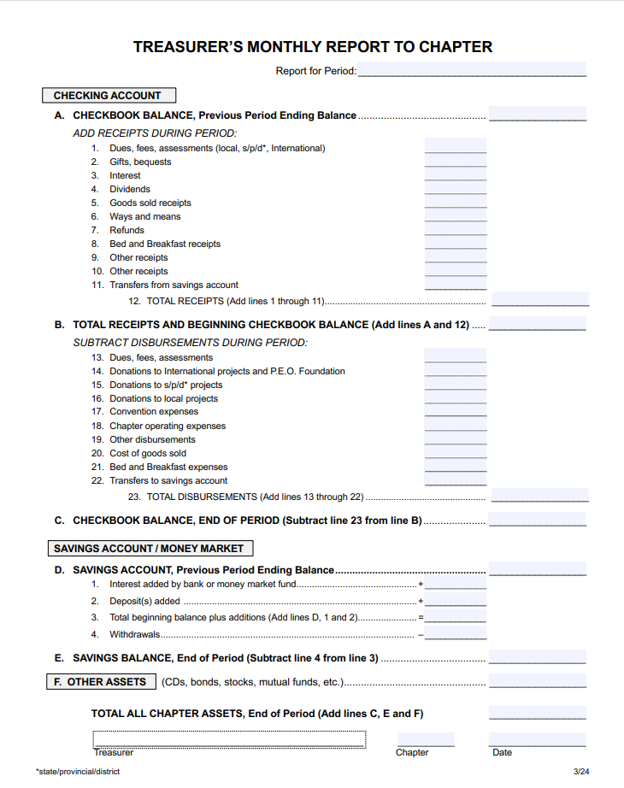
Give a monthly Treasurer’s report. (rev 2/25)
Provide:
Beginning Checkbook Balance
Total Receipts
Total Disbursements
Total Chapter Assets
To purchase the Local Chapter Accounting Program, please send an email to LCaccounting@peodsm.org
PC and MAC versions available.
Notes:
It is the treasurer’s responsibility to give a monthly Treasurer’s report. You only need to provide the beginning balance, total receipts, total disbursements and total chapter assets. Your chapter may have the downloadable ledger sheet that you manually fill in or your chapter may have previously purchased the ledger that automatically generates a Monthly Treasurer Report.
To purchase or request more information about the Local Chapter Accounting Program, please send an email to LCaccounting@peodsm.org. PC and MAC versions available.

Slide 23
Monthly Report Errors
Check your dates and make sure the year is correct on all entries
Compare your total receipts & disbursements with bank statement deposit and check totals to locate discrepancy
If you still have issues, reach out to your chapter board buddy
If none of these resolve your issue, ask for help from: LCaccounting@peodsm.org
Quick Checks for Common Errors
Using the Local Chapter Accounting Program
Notes:
If you find that your monthly reports are not accurately reflecting your check register, there are a few quick checks for common errors.
Be sure to check your dates of entries to ensure that they are correct. If you have incorrectly entered dates, your monthly report won’t capture those entries as that report is generated based upon dates.
Compare your total receipts and disbursements with the bank statement deposit and check totals to locate any discrepancies.
If you still have issues, reach out to your chapter board buddy. If noe of these options resolve your issue, then ask for help from LCaccounting@peodsm.org.

Slide 24

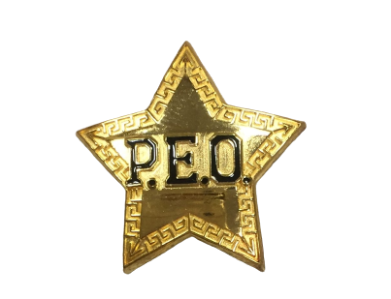

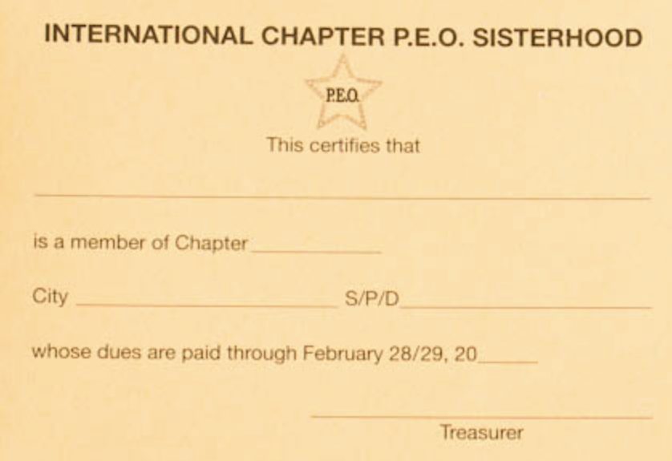
Order Supplies:
Membership Cards
Invitations to Membership
New Member Welcome Kit
Project Info Cards
Officer Binders
Use the Local Chapter Supply Order Form (rev 1/25)
Order emblem for new initiate AFTER the Corresponding Secretary has reported their membership to International.
Notes:
Anytime the chapter needs to order supplies, the treasurer will be instructed to order them from the International Website.
Orders should not be placed until a it has been voted and approved by the chapter.
Emblems should not be ordered until the Corresponding Secretary has reported the new sister’s membership to International.

Slide 25

Present/Pay Bills
Bills should be presented to Treasurer prior to the meeting.
Ex: “Madam president, I move to reimburse Gaby for $13.25 for Birthday Cards.”
Notes:
Bills should be presented to Treasurer prior to the meeting.
After the president says “Are there any bills to be presented?” you will respond “Madam president, I would like to make a motion to reimburse Gaby for $13.25 for Birthday Cards.”

Slide 26

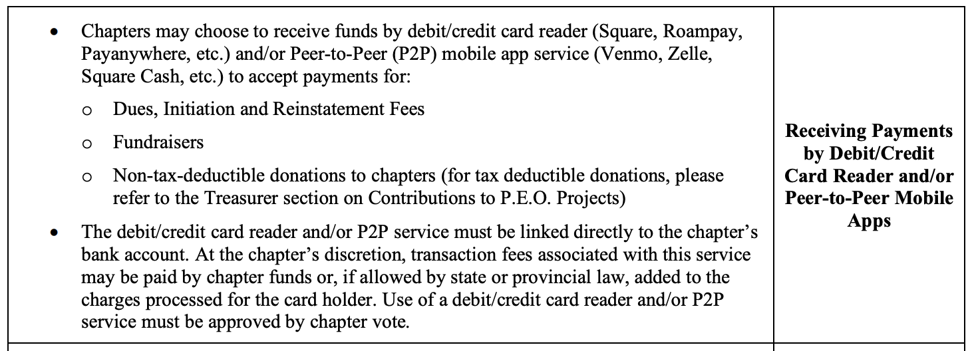
Can we use Venmo?
Venmo
PayPal
Zelle
Debit Card
Credit Card
Notes:
We get asked this question all the time. Guess where you can find the answer? IOLC

Slide 27
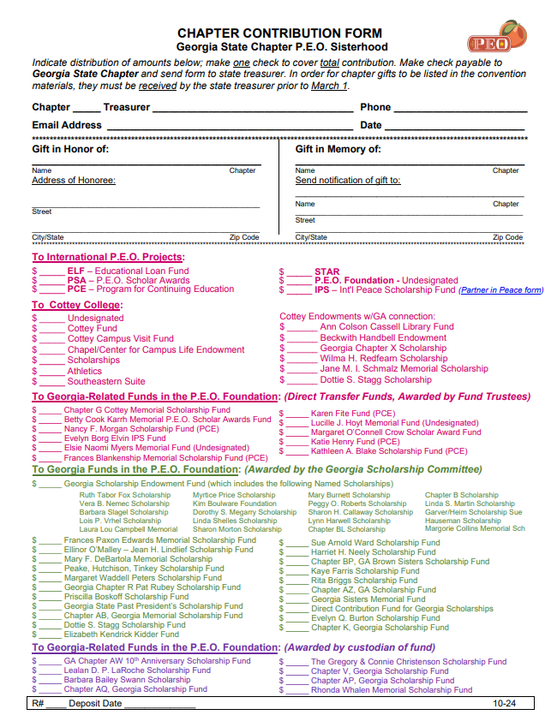
Make all chapter donations.
MUST use Chapter Contribution form on the GA website (resources tab)
Mail to GA State Treasurer (see roster)
Make check payable to “GA State Chapter”
Notes:
All chapter donations must be accompanied by a Chapter Contribution Form. This way the State Treasurer can collect all of the information needed for your chapter’s donation. This form can be found on the Georgia website under Resources and clicking on Documents & Links.
Your check and contribution form should be mailed to the State Treasurer. Please see the state roster under Documents & Links on the GA website for her mailing address. Laura will be the Treasurer until May 18th, after that all checks will need to be mailed to Amy who will be the new Treasurer at that time.
All checks must be made payable to GA State Chapter

Slide 28
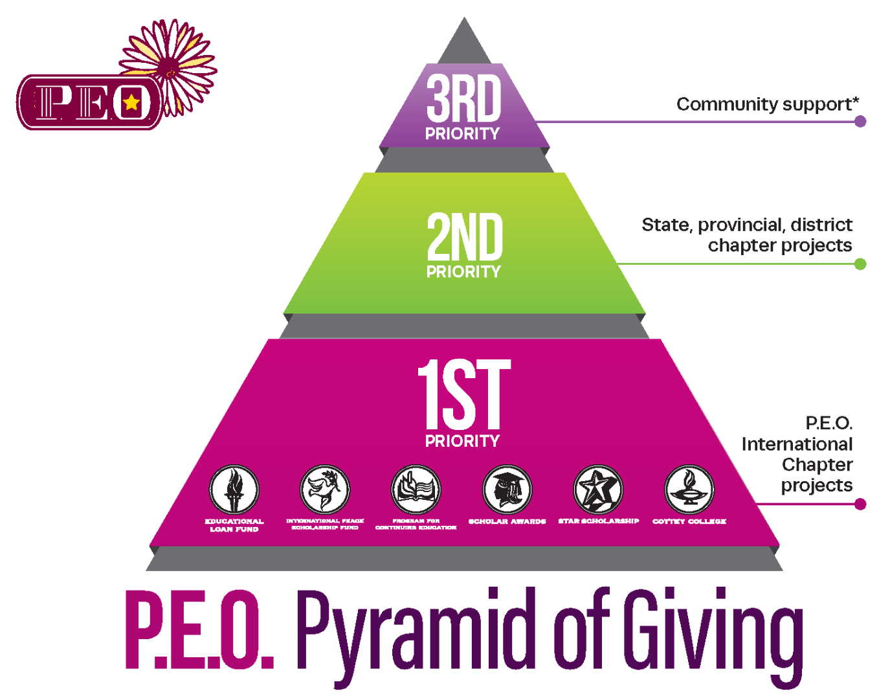
In order to maintain compliance with the IRS, chapters are encouraged to give more donations to:
International > Georgia > Local
Community support includes honorariums for chapter speakers, minimal gifts to project applicants and local chapter scholarships (whether paid directly from chapter funds or chapter donations made to those held in the P.E.O. Foundation).
Notes:
In order to maintain compliance with the IRS, chapters are encouraged to give more donations to International projects than they do to Georgia projects and more to Georgia projects than they do to Local community support. Community support includes honorariums for chapter speakers, minimal gifts to project applicants and local chapter scholarships (whether paid directly from chapter funds or chapter donations made to those held in the P.E.O. Foundation).

Slide 29
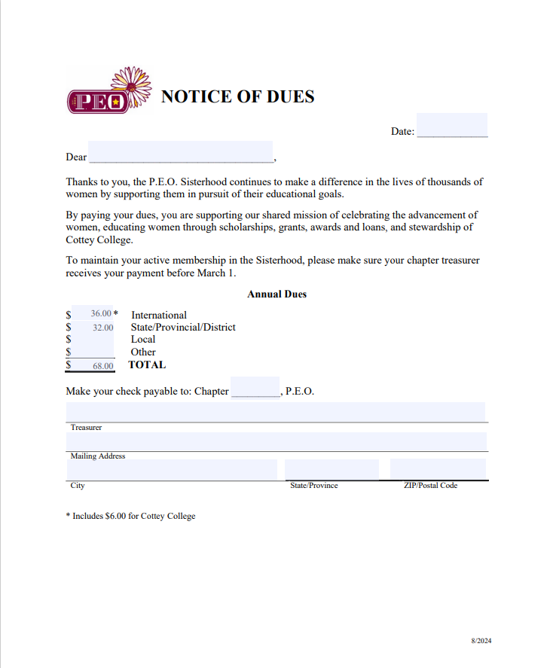
Collect dues in February (or earlier!)
A Notice of Dues form (optional) is located on the International website.
Last chapter check written for the year is dues (dated before March 1).
Provide each member with a signed Membership Card for her records.
Notes:
It is the responsibility of the chapter Treasurer to collect dues in February (or earlier!)
A Notice of Dues form (optional) is located on the International website.
Once all dues have been collected, the last chapter check written for the year is the dues check.
Provide each member with a signed Membership Card for her records.

Slide 30
Annual Reports
Treasurers, Corresponding Secretaries & Presidents
Notes:
Annual Reports take place in March and require the teamwork of the treasurer, corresponding secretary and president. In 2023, International launched a fully-digital electronic Annual Reporting system.

Slide 31
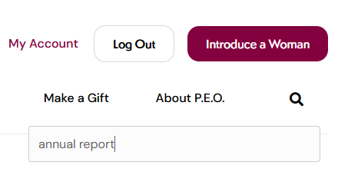
Watch the P.E.O. Electronic Report Training video on the International website:
Resources > Local Chapter Officers > Annual Reports.
Training videos are posted in February.
Notes:
All Treasurers and Presidents are to watch the P.E.O. Electronic Report Training video on the International website by going to Resources > Local Chapter Officers > Annual Reports.

Slide 32
MARCH 1: link & login instructions sent to chapter treasurer
STEP 1: Corr. Sec.
STEP 2: Treasurer
STEP 3: President
DUE MARCH 10
NEW for 2025! Early review and update of the Membership Roster Between January 1 and February 24, local chapter corresponding secretaries will receive an email with instructions to review and update their Membership Roster on the P.E.O. International website by going to Manage Membership, then clicking on Access Member Update form.
After the Treasurer submits the completed Membership Roster, Dues Form, and the IRS-LC and signs out of the system, an automatic email notification will be sent to the president.
After the President submits approval of Roster and Dues forms and signs out of the system, an automatic email notification will be sent to the GA State Treasurer.
Notes:
It is highly recommended that Treasurers begin Step 2 as close to March 1 st as possible in order to give the other President ample time to complete Step 3 by March 10.
It is also highly recommended that Corresponding Secretary should update member contact information and membership status as they arise throughout the P.E.O. year to reduce the workload during the annual reporting process.
The Treasuer’s and President’s steps are linked in sequence: once each step is submitted, the subsequent officer is alerted by automatic email notification and allowed access to complete her step.

Slide 33
FINAL STEP: COMPLETE THE IRS-LC
LINE D MUST EQUAL LINE E.
Treasurer selects IRS-LC from forms listed under treasurer’s login.
Treasurer completes and submits the form. It is routed to the local chapter president for review and approval.
President directs Treasurer to send dues form and check to State Treasurer.
Helpful resources to have on hand while completing the IRS-LC:
IRS-LC Worksheet
Monthly Treasurer’s Report (Mar 1-Feb 28/29)
Tax ID#
Notes:
The final step of annual reporting is completing the IRS-LC. The treasurer can select the IRS-LC from the forms listed under the treasurer’s login. Once the treasurer completes and submits the form, it is routed to the local chapter president for review and approval.
It is recommended that treasurers print the IRS-LC worksheet and begin filling it out to make online entry more efficient. By running the treasurer’s monthly report using the fiscal year beginning and ending dates will provide most of the figures needed. For chapters using manual ledgers, you should be able to capture the necessary figures in the totals of each of your columns.
Line D MUST EQUAL Line E.
When chapter presidents have approved and submitted the three previously mentioned steps AND IRS-LC, the state treasurer will automatically be alerted by email and allowed access to begin processing the local chapters.

Slide 34

President/Vice President

Slide 35
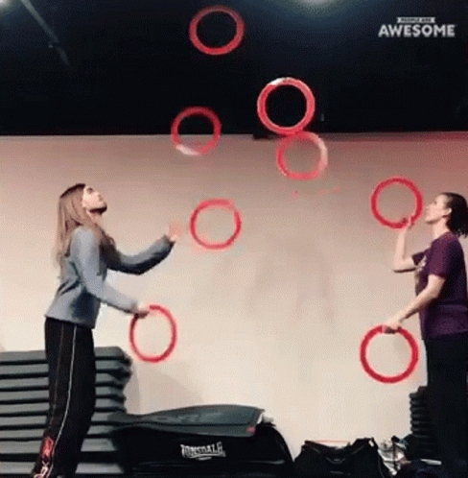
It’s a juggling act!
But you can’t do it alone! Delegation is key.
Notes:
Being President does not mean you have to do it all! Use your resources and delegate!

Slide 36

Be responsible for the safekeeping of the President’s supplies:
President’s Book
COI Booklets
IRS #
Chapter Charter
President’s letters
Sponsor for Membership forms
Annual Report
Put printed IOLC behind the IOLC tab in the President’s Book
Notes:
The president is responsible of the safekeeping of these chapter supplies. If you can not find these supplies, reach out to your board buddy.
The retention list in the IOLC tells you exactly how many years each of these supplies should be kept.

Slide 37

Conduct all meetings from the President’s book.
The President’s Book is a complete script that provides step-by-step instructions.
Note: President’s book is available online for reference but can not be printed, downloaded, or emailed.
Notes:
The president will conduct all meetings from the president’s book.
The President’s Book is a complete script that provides step-by-step instructions.
President’s book is available online for reference but can not be printed, downloaded, or emailed. In an emergency situation, you would be able to conduct a meeting from your laptop.

Slide 38
Tabbed Sections
Chapter Meeting (rev 1/24)
Appendices (rev. 1 & 6/22 & 1/24)
Special Meeting (rev. 1/22, 1/24)
Installation (rev. 1/22, 1/24)
Initiation (2024 Books)
IOLC (rev. 7/22 & 2/24)
Bylaws (GA bylaws rev. 2024)*
Counsel Booklet (9/24)
*Additional revisions to occur after convention in May of this year.
President’s Book
Notes:
You will find these 8 tabs in your president’s book. Familiarize yourself with all the sections and make sure they are up to date.

Slide 39
Chapter Meeting
Call to Order
Opening Ode/Objects & Aims
Devotions
Minutes
Initiation
Report of Treasurer
Report of Corresponding Secretary
Committee reports
Unfinished Business
New Business
Presentation of Names for Membership
If applicable:
Sponsor for Membership
Proposal for Membership
Balloting
Election
Installation
Remarks by Visitors
Suggestions for the Good of the Chapter
President’s Book
Notes:
The first tab in your president’s book is the procedure for a P.E.O. Chapter meeting. A meeting is run in this order.
Please note that stating “Are there any names to be presented for membership?” is required to be said at every meeting under the Presentation of Names for Membership section.

Slide 40
Appendix of Supplementary Procedures
General Information
Business at a Special Meeting
Procedure for Election of Chair Pro Tem
Preparation for Initiation
Amend Local Chapter Bylaws & Standing Rules
Treatment of a Main Motion
Counted Ballot
Invitation to Transfer
Sponsor for Membership Form Not Receiving Three Signatures
Balloting Procedure
Votes Cast Exceed Number Entitled to Vote
Election of Officers, Delegate(s) and Alternate(s)
Installation of Officer Elected but Not Installed
Reaffirmation of Vows
President’s Book
Notes:
The information behind the “Appendix” tab provides instruction on additional meeting procedures. Don’t forget about this section. It is often where you can find the answer hiding to a question that you have.

Slide 41
Special P.E.O. Chapter Meeting
Business which CAN be transacted at a Special Meeting
Acceptance letter of transfer
Audit report
Initiation
Invitation renewed
Name presented and proposed
Official Visit
President’s Letter
Report of Convention
Re-presentation of a name
Request for ELF loan
Voting on sponsoring a project recipient
Business which CANNOT be transacted at a Special Meeting
Balloting on a name
Consideration of a request for reinstatement from an expelled member
Invitation to transfer
President’s Book
Notes:
There are times when your chapter may need to call a Special Meeting. Remember, a special meeting may be done virtually or hybrid or in-person. But not via EMAIL. All members must be notified of the specific business to be conducted at the special meeting prior to the meeting, and only that specific business may be conducted.

Slide 42
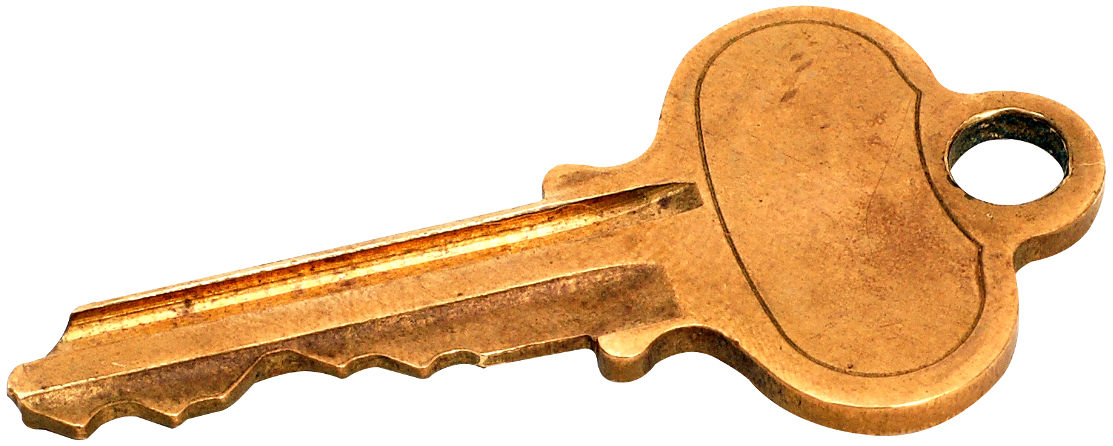
Tips for running a swift & successful meeting:
Use meeting a agenda (template online)
Use a committee sign-up sheet
Read through the meeting in advance
Invest in sticky notes!
Arrive early, start on time!
With chapter vote, the reading of minutes can be foregone only if all members have received the DRAFT minutes. Provisions for those without email addresses must be made.
Ensure officers & committees understand roles/expectations
Ask committees to do their work outside of the business meeting & come ready to present a final summary
Help minimize idle conversations
Understand and implement proper procedures.
Make the meetings fun. If you are not having fun why would anyone else be?!
Preparation is key!
Notes:
Plan for your meeting with an agenda; have committees sign up if they have a report to make; plan for items of business before the meeting; use post it notes to cover up items not being addressed in a particular meeting (for example, cover the procedures for election of officers when you are not electing officers); If your chapter has voted to update bylaws allowing for draft minutes to be distributed to your chapter members prior to meetings, then the reading of the minutes during the meeting may be foregone; ensure that your officers and committee chairs understand their roles and responsibilities and have the committees conduct their business prior to reporting at chapter meeting; help minimize idle conversations and follow all P.E.O. procedures.
But most of all, HAVE FUN!

Slide 43
Timeline
Official Visits/Board Buddy Calls
Annual Report Release letters
GA State Convention
Officer Transition Meeting
Submit Yearbooks
Submit ByLaw Changes
Local Chapter Workshops
International Convention
Chapter Designation Donations
Int’l P.E.O. Day of Service
Installation of Officers
Dues are due
Appoint Committees
President’s
Letter
March April May June Sept Oct Nov Jan Feb
Notes:
Here is a timeline highlighting some of the important dates during your year as president of which you’ll need to be aware.
March is the beginning of the Local Chapter fiscal year which includes the installation and transition of chapter officers, appointing committees, submitting any bylaws changes, local chapter workshops and annual reporting. You should receive annual report release letters in April.
Our annual state convention is always held in May. Once you have received new information disseminated during convention, you may update your yearbooks with the newly elected state secretary, new state committee chairs, important dates for workshops and chapters to receive official visits in the Fall. Electronic yearbooks are due by July 1 to your chapter board buddy.
This September (2025) there will be a Convention of International Chapter in Phoenix, Arizona. Ten chapters in Georgia are eligible to attend. For the distinction of being recognized at convention as a Designated Chapter, lump sum contributions need to be received by the state treasurer by January. Celebrating our founding January 21st 1869 through participating in International’s P.E.O. Day of Service in January, though chapters have celebrated our founding in February and March. Dues and President’s Letters are due in February and that brings us back to the beginning = March.

Slide 44
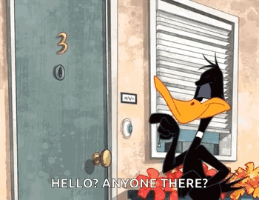
Official Visits
Purpose:
Celebrate successes
Assess any needs
Offer assistance
Approximately every 3 years, schedule is announced at convention..
Presidents contacted well in advanced and given detailed instruction of what to expect.
Notes:
The purpose of an official visit is to allow local chapter an opportunity to spend individual time with the members of the Georgia P.E.O. Executive Board.
Celebrate successes
Assess any needs
Offer assistance
In Georgia, Official Visits are set to occur approximately every 3 years. Chapters that will be receiving an Official Visit this year will be announced at convention.
Presidents will be contacted by the visiting officer well in advance of the visit and be given detailed instruction of what to expect.

Slide 45
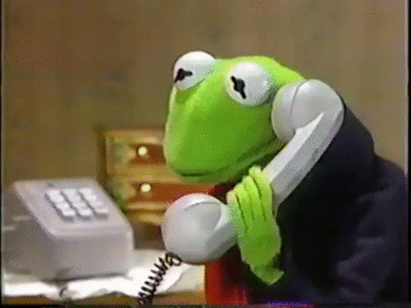
Board Buddy Calls
If your chapter is not scheduled for an Official Visit…
…the chapter president and her Board Buddy will have a phone call or zoom meeting in the fall.
A Board Buddy call is a condensed version of an Official Visit.
Notes:
If your chapter is not scheduled for an Official Visit…
…the chapter president and her Board Buddy will have a phone call or zoom meeting in the fall.
A Board Buddy call is a condensed version of an Official Visit. Your Board Buddy will provide you with all of the information you need prior to the call. No surprises!

Slide 46

Bonus tip!
You don’t have to wait for the President to be absent to preside over a meeting.
Practice running a meeting when the president is in attendance!
She will be right there to assist with any questions you may have and you will feel more comfortable running a meeting in the future.
For Vice Presidents
Notes:
You don’t have to wait for the President to be absent to preside over a meeting.
Practice running a meeting when the president is in attendance!
She will be right there to assist with any questions you may have and you will feel more comfortable running a meeting in the future.

Slide 47
Resources
Guard
Guard’s Instructions for COI
Chaplain
Chaplain’s Prayer Card
Recording Secretary
Minutes Template
Instructions for Minutes
Recording Secretary Training Video
Corresponding Secretary
Monthly Report
Local Chapter Corresponding Secretary Forms:
State Convention Delegates
Local Chapter Report of Project Chair
Report of Election of Officers of Local Chapter
Member Update
Corresponding Secretary Training Video
Notes:
The next two slides contain links to all of the documents referenced in this presentation.

Slide 48
Resources
Treasurer
Roll Call
Monthly Report to Chapter
Order Supplies
Chapter Contribution Form
P.E.O. Pyramid of Giving
Notice of Dues
Instructions for Treasurer’s Record Book
Treasurer Training Video
P.E.O. Treasurer’s Excel File Instructions
President/Vice President
List of Supplies for Local Chapter Officers
President’s Book:
Procedure for P.E.O. Chapter Meeting
Procedure for Special P.E.O. Chapter Meeting
Appendix of Supplementary Procedures
Bylaws & Standing Rules of the GA State Chapter
Annual Report
Local Chapter Annual Report Resources
IRS-LC Worksheet
Notes:
Click to add speaker notes

