Slide 1
LET’S TALK
PCE!
ABOUT

Slide 2

P.E.O. Program for Continuing Education
PCE

Slide 3


What is the P.E.O. Program for Continuing Education (PCE)?
Established in 1973 to provide need-based grants to women in the U.S. and Canada whose education has been interrupted and who find it necessary to return to school to complete a degree or certification that will improve their marketable skills for employment to support themselves and/or their families.
Shannon Budnick, PCE Recipient
Funding Grants Today … For a Brighter Tomorrow

Slide 4
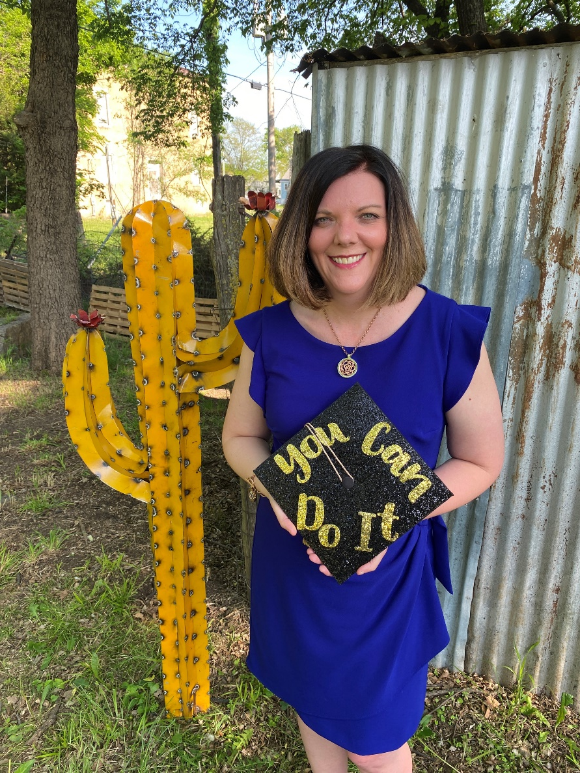
PCE Grant Information at a Glance
Maximum grant $4000
One-time grant regardless of amount awarded
24 consecutive months break in education
For educational expenses not living expenses or educational loan repayment
Payment made directly to recipient
PCE recipient Loni Heinen

Slide 5
PCE Eligibility Requirements
A woman is eligible to apply provided she:
Is recommended by a P.E.O. chapter
Is enrolled in a certification or degree program from an accredited institution; has not already earned a master’s degree or above
Is a citizen or legal permanent resident of the U.S. or Canada
Is living and studying in the U.S. or Canada for the entire course of study
Has had at least 24 consecutive months as a non-student sometime in her adult life
Is within 18 consecutive months of completing her educational program
Is enrolled in an educational program which, at the conclusion, will lead to employment or job advancement

Slide 6
Amount & Use of Grant
The maximum grant is $4000. A request for less than a maximum grant is encouraged when the full amount is not essential. The total grant awarded is based on the availability of funds and applicants’ individual needs.
The grant is intended for educational expenses such as:
Tuition
Books and supplies
Testing and graduation fees
Transportation (gas, parking, local bus fare, not auto loan payments or maintenance)
Childcare (only while in class or studying)
Uniforms required by educational program
Equipment/tools necessary for the course of study

Slide 7

Grant Timeline
Applications are processed year-round!
A chapter recommendation must be submitted no less than eight weeks prior to the term start date for which the grant is requested
However, a recommendation cannot be accepted more than fourteen weeks in advance of the term start date

Slide 8
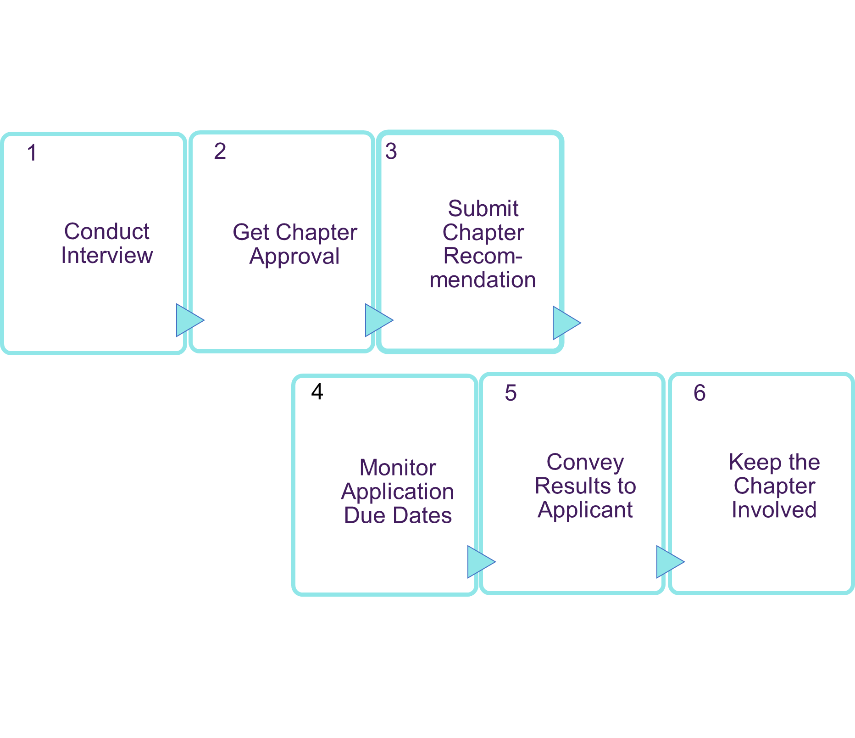
Sponsoring an Applicant

Slide 9
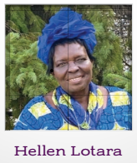


Variety of student
ages and degrees
PCE recipient Jessica Jones hopes to teach welding at the high school or college level and wants to encourage other women like P.E.O. has done for her.
Former Sudanese Refugee’s
Quest for Continuing
Education Boosted by
The Power of P.E.O.
At age 62, Hellen has never
wavered in her quest to pro-
mote education for all. “Someone must be ready to sacrifice to create change,” says Hellen.

Slide 10
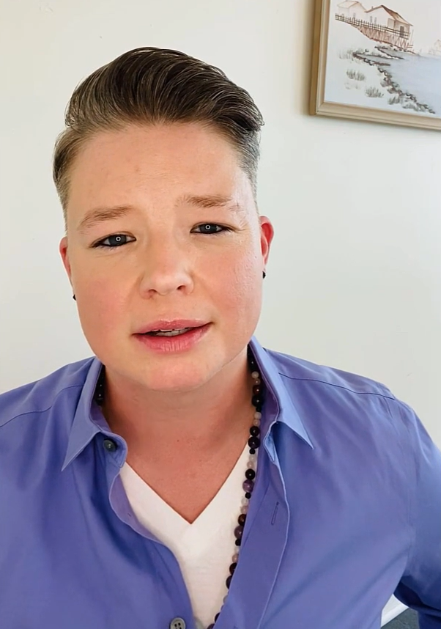
PCE Recipients
say
“To all the strong and supportive women of P.E.O. who’ve become friends and mentors, I’m overcome with gratitude.”
– MAGGIE LINDLEY
P.E.O. PROGRAM FOR CONTINUING
EDUCATION GRANT RECIPIENT
thank you!
“I cannot express enough, my gratitude for providing me with this scholarship! You have lifted such a burden off my chest with fears of not having enough in order to complete my education. Thank you all so much!
“The world can be a scary and frustrating place and it helps so much to know that there are organizations like P.E.O. that are willing to lift up others.”
“PCE supports women taking on various brave and difficult life choices by offering a community where betterment is valued and appreciated. I view this grant as a direct extension of the community that you have committed to foster.”

Slide 11
Finding PCE applicants
PREVIOUS NOMINEES
TRADE SCHOOLS & COLLEGES
WORD OF MOUTH
NETWORK
Post a PCE flyer where teachers, health professionals and other community members will see it
Continue contact with chapter sponsored applicants for other projects for potential PCE eligibility
Establish contacts with local trade schools, community colleges and universities
Talk about or utilize PCE flyers during chapter events and update chapter with PCE programs available on the website

Slide 12

Become a Brighter Tomorrow Chapter
The Program for Continuing Education offers hope and a brighter tomorrow for women whose education has been interrupted and who find it necessary to return to school to support themselves and/or their families. Now, local chapters have an opportunity to earn the Program for Continuing Education Brighter Tomorrow designation as they continue to lift up women who are working to create better futures for themselves.
hope and a brighter tomorrow
AMOUNT: $500 lump sum donation
DUE DATE (For Current Year Recognition) BY: January 31 to your state/
provincial/district treasurer

Slide 13
Named and Endowed Grants
PCE Named Grants and Endowed Grants provide the opportunity for individuals, families, and chapters to make special gifts to the P.E.O. Program for Continuing Education. Each of these full grants can be named by the donor and may be made in honor or in memory of an individual or a chapter. The recipients of Named and Endowed grants are chosen by the PCE Board of Trustees.
AMOUNT: Donations in increments of $3000
INFORMATION: Follow the “PCE Quick Links” on the International website for more information

Slide 14

P.E.O. Program for Continuing Education
Funding Grants Today...For a Brighter Tomorrow
Thank you!
For your…
– nominations
– donations
– support
YOU ensure PCE continues to help women have a brighter tomorrow!

