Slide 1
Attracting & Engaging the Next Generation of P.E.O.s
Kathleen Blake, GA State President
Katie Frick, WY State President
Notes:
KATHLEEN
Katie Frick and I were approached in 2021 by P.E.O. International and asked to serve as moderators for a virtual chat room titled “Connecting & Engaging with Younger Members”. The email said, “I promise your task as a moderator for these sessions is fairly simple. You’ll act as a hostess, providing a smile and a greeting. Then, you’ll introduce yourself as moderator and start the conversation. You do not need to have a presentation prepared as we want these to be open conversations.” Katie and I very quickly said that sounds easy enough and prepared some questions. The night before we were to go live I called Katie in a panic. Over 300 people had signed up to attend. You can’t get 3 P.E.O.s in the same room without them all talking over each other, let alone 300. So Katie and I quickly jumped on a zoom with 24 hours to spare and come up with 30 mins worth of engaging content. We were able to make it look like we knew what we were doing. Our little dog and pony show surprisingly went well that day.
The workshop we will present this morning was created from that slightly chaotic evening in 2021. It is a bit more polished. We also found that adjusting the title from targeting “younger P.E.O.s” to the “next generation of P.E.O.s” was more inclusive and relatable to our audiences. It is not always about building your chapter for the next generation of women, in their 20s or 30s, but rather the next generation of P.E.O.s. The next generation of P.E.O.s may be made up of women from many different generations.

Slide 2
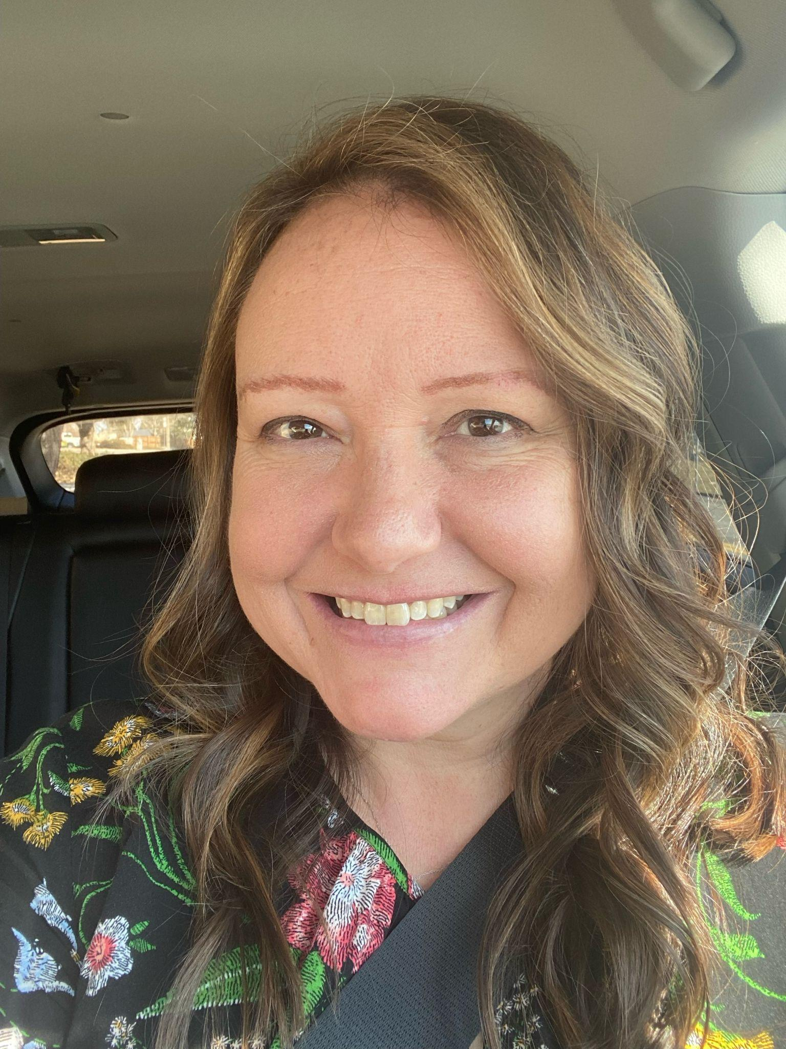
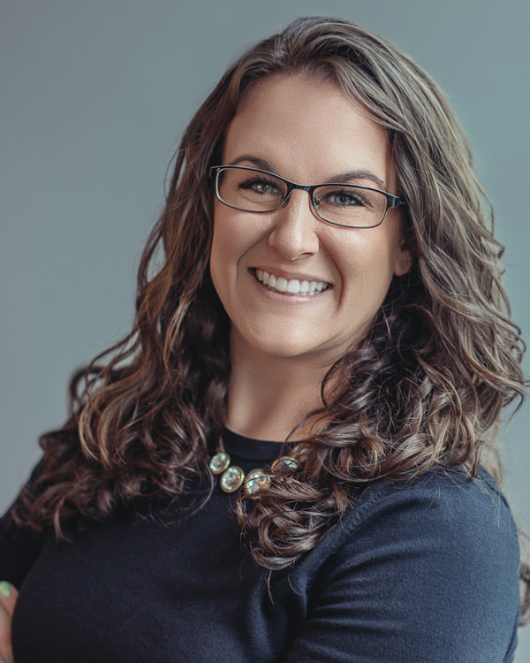
We bring greetings from WY & GA!
Katie Frick, U, Wyoming President
Lives in Arvada, CO with husband & 2 daughters (age 11 & 15)
2nd generation P.E.O.
Took an early retirement from media planning to be a stay-at-home mom, which involves very little time actually staying at home
Enjoys quilting, or at least buying fabric and Pinterest-ing patterns
Kathleen Blake, A, Georgia President
Lives in Atlanta GA with wife & fat cat
5th generation P.E.O.
Works full-time as Chief of Staff at an ad agency
Self-proclaimed doughnut connoisseur
Visited all of Georgia’s 48 state parks

Slide 3
Communication Across Generations
Evaluate & Adjust Messaging
Source: Science of People, How to Communicate With People From Different Generations, By Vanessa Van Edwards
Notes:
KATIE
You’ve probably figured out by now that different generations communicate differently. Communicating across generations is less about changing your style of communication and more about understanding someone else’s style of communication. We are going to review how different generations communicate based on actual studies. You may find yourself really identifying with some of these or you may not. These are overarching generalizations.

Slide 4
Gen Z
(Born after 2000)
What They Value: Direct and fun communication, they have very short attention spans.
Communication Tip: Get right to the point. Use their preferred mode of communication. Shoot them a text. Send a Google Calendar invite. Go where they already are. If you can make it bite-sized and fun they are much more likely to pay attention. Beware of lectures–they will tune out.
Notes:
KATIE
Raise your hand if you were born after 2000? This is my daughter…
What They Value: Direct and fun communication, they have very short attention spans.
Communication Tip: Get right to the point. Use their preferred mode of communication. Shoot them a text. Send a Google Calendar invite. Go where they already are. If you can make it bite-sized and fun they are much more likely to pay attention. Beware of lectures–they will tune out.
Ex: Gigi - movie night texts, so much easier than Evites.
If you say you are going to have a 30 min zoom meeting. Make sure it is a 30 min zoom meeting.

Slide 5
Millennials
(1980-2000)
What They Value: Self-expression. Millennials love to express themselves, add their own mark and have their opinion represented.
Communication Tip: Ask their opinion, value their ideas and let them help construct the solution with you. Approach a millennial in the brainstorming stage before you have an idea formed. This will help them feel buy-in and that they are on the same team as you.
Notes:
KATHLEEN
Where are my fellow millennials?!
What They Value: Self-expression. Millennials love to express themselves, add their own mark and have their opinion represented.
Communication Tip: Ask their opinion, value their ideas and let them help construct the solution with you. Approach a millennial in the brainstorming stage before you have an idea formed. This will help them feel buy-in and that they are on the same team as you.
There have been many times when I was met with “we are so glad to see young people in P.E.O. We need the new ideas and energy” and then have those same ideas and suggestions brushed off because they were too much and not what we we’ve already done. Be careful you are not simultaneously asking for their opinion and then squashing it.
Find a way to bridge the gap between tradition and progress by asking their opinion.
EX: What are some things the chapter could do to engage more people of our community?
EX: Do you have any suggestions to new fundraisers?
EX: Show your yearbook to a new member and ask her what she might do differently?
Try it, if it doesn’t work, adjust or go back to what did. They will feel valuable and more likely to continue to come up with new ideas and take on new projects.

Slide 6
Gen X
(1965-1979)
What They Value: Shared responsibility. They want partners, helpers and support from the people around them.
Communication Tip: Anytime you want to reach out to an Xer, you will get a better response if you try to address their needs and take pressure away from them. Consider, “would you like to put your event planning expertise to use?” rather than just asking for help, and you will get a great reply and lots of gratitude.
Notes:
KATIE
Where are my fellow Gen Xers?
What They Value: Shared responsibility. They want partners, helpers and support from the people around them.
Communication Tip: Anytime you want to reach out to an Xer, you will get a better response if you try to address their needs and take pressure away from them. Consider, “would you like to put your event planning expertise to use?” rather than just asking for help, and you will get a great reply and lots of gratitude.
Make these sisters feel valued and included in the community of your chapter. Find ways to simplify committee and officer work, and streamline meetings to work into busy lives.
Millennials - independent thinkers
Gen X - more collaborate

Slide 7
Boomers
(1946-1964)
What They Value: Respect & tradition. Boomers have reached an age where they want respect from younger counterparts, fear losing the traditions they hold dear. Some lament the loss of in-person communication in a digital age.
Communication Tip: Respect should be paramount. Whether you are discussing a new idea or working through conflict, respecting a boomer’s life experience and opinion is key to effective communication.
Notes:
KATHLEEN
I know we have some Boomers in the house!
What They Value: Respect & tradition. Boomers have reached an age where they want respect from younger counterparts, fear losing the traditions they hold dear. Some lament the loss of in-person communication in a digital age.
Communication Tip: Respect should be paramount. Whether you are discussing a new idea or working through conflict, respecting a boomer’s life experience and opinion is key to effective communication.
P.E.O. is very unique in that we are a multi generational organization. I imagine there are not a lot of spaces that you are in that ranges from age 18 to 118. As we continue to embrace more options in P.E.O., this is another example of why we must be providing opportunities for in-person fellowship for Boomers and also embracing bite-sized communication for Gen Z . If we charge into the future and leave sisters behind, the chapter does not benefit.
In P.E.O., Boomers might sometimes feel like the young kids want to come in, take over and do away with tradition. My advice to Gen X, Millennials and Gen Z…when working with Boomers, ask them to share the history, ask them if there is anything you are not thinking about or forgetting. Value their opinion; it is one of great knowledge. When you value their opinion you earn their respect and reduce barriers.

Slide 8
Silent Generation
(Born before 1946)
What They Value: They have seen more than any of us could imagine. They want to enjoy life and share their lessons learned. Let them tell you as many stories as they want and always bring them their favorite dessert—they deserve it!
Communication Tip: Let them communicate with you however they want. Listen and learn.
Notes:
KATIE
Are we lucky enough to have to be graced with the presence of anyone from the Silent Generation?
What They Value: They have seen more than any of us could imagine. They want to enjoy life and share their lessons learned. Let them tell you as many stories as they want and always bring them their favorite dessert—they deserve it!
Communication Tip: Let them communicate with you however they want. Listen and learn.
Treat them like the queens they are. Find ways for these sisters to participate that work best for them. Ask these sisters how they would like to participate, and offer rides and other accommodations to meet their needs.
Don’t assume they don’t want to do anything.
EX: Sister who attends chapter meetings in two different chapters

Slide 9
Attracting Prospective Members
Notes:
KATHLEEN
Let’s talk about attracting prospective members. We will review how to plan successful socials, evaluate our terminology, cancel assumptions and reset financial expectations.

Slide 10
ATTRACTING PROSPECTIVE MEMBERS
Planning successful socials
Use a time range
Allow people to “drop in” and “swing by”
Make room for “maybes”
Committing to an event can be stressful and plans change!
Choose spaces you can mingle
Seated meals only allow you to talk to a couple people
Use events/socials nearby:
Another chapter’s fundraiser
Farmer’s Market
Convention dinner
Founder’s Day event
Tailgate
Local Festival/Rodeo
Notes:
KATHLEEN
Planning socials for sisters to meet potential members can be a lot of work! But it doesn't have to be.
Use a time range - Allow people to “drop in” and “swing by”. With today’s fast paced and ever changing world, women are more likely to stop in when there is not a firm time.
Make room for “maybes” - Committing to an event can be stressful and plans change!
Choose spaces you can mingle - Seated meals only allow you to talk to a couple people, try a space that allows for people to talk to more than just the person on either side of her.
This is my favorite…do less! Use events/socials nearby:
Another chapter’s fundraiser (how many of you did a joint social or fundraiser this year? Hopefully it meant less work and more guests.
Farmer’s Market
Convention dinner
Founder’s Day event
Tailgate
Local Festival/Rodeo
Don’t be afraid to invite friends or family who are not necessarily interested in joining. Community engagement and exposure of any kind leads to an increase in membership, an increase in funding, and an increase scholarship candidates. I will sometimes hold socials and invite P.E.O.s from other chapters and they invite friends and family. One of my best friends would always come who said she wasn’t interested in P.E.O. I said no problem, just come and have fun. She just couldn’t help herself and a couple years later she is now my P.E.O. sister. Katherine said it best, “If you sit around the campfire long rough, you’ll eventually catch a spark.
“

Slide 11
ATTRACTING PROSPECTIVE MEMBERS
Evaluate & adjust chapter terminology
Instead of:
Laramie Reciprocity Tea
Slacks and a blouse
“Do you want to come
to a P.E.O. Membership Informational meeting?”
Trifold Brochures
Christmas Auction
Try:
Laramie P.E.O. Taco Tuesday
Black bottoms and white top
“Do you want to hang out my friends and me this Friday ?”
Attachment, link, QR code
Holiday Auction
Notes:
KATIE
(review slide)
Consider updating the way your chapter discusses socials. Some traditions are fun! Sometimes trying new things is fun too!!

Slide 12
ATTRACTING PROSPECTIVE MEMBERS
Cancel Assumptions
She’s too busy…
She won’t like our traditions…
She lives too far away…
She won’t want to hang out with us old people…
…Let her decide.
Don’t guess what prospective members want. Ask them!
JUST ASK: Turning Assumptions into Introductions to New Members
Notes:
KATHLEEN
When I ask members if other women in their life would be interested in P.E.O., they often say:
“She’s too busy…”
“She won’t like our traditions…”
“She lives too far away…”
“She won’t want to hang out with us old people…”
But have you asked or are you just assuming they feel that way. I feel so strongly about this that I helped create an entire Period of Instruction on this very topic in 2023. It is titled “Just Ask: Turning Assumptions into Introductions to New Members” and can be found on the Membership page of the Georgia P.E.O. Website where you’ll see Katie debut as a teenager.
My Chief Inclusion Officer often says “Don’t talk about us without us”. This references making decisions for members of a community without any members of that community in the room. Be careful when determining what a specific demographic of women do and do not want without including them in the conversation. And remember members of a certain group do not always want the same thing.

Slide 13
ATTRACTING PROSPECTIVE MEMBERS
Reset Financial Expectations
P.E.O. welcomes women of all economic backgrounds.
New members may be intimidated by:
Amount of money sisters “waive”
Providing food, decorations, supplies, etc.
Gift giving traditions
A sister’s time, energy and great ideas are just as valuable her money. But is that the message your chapter is advertising?
Notes:
KATIE
P.E.O. welcomes women of all economic statuses. New members may be intimidated by:
Amount of money a sister waives
A new member might see the Courtesy Committee buying cards and stamps and never being reimbursed and get the impression that they are not welcome if they are not able to cover the expenses.
Providing food, decorations, supplies
If a potential member notices that co-hostesses provide full meals at meetings or centerpieces at events they may hesitate to join knowing they are unable to cover those costs.
Gift giving traditions
Your chapter may have customs that involve giving gifts, like the outgoing president buying gifts for her officers. Or holiday gift exchanges.
A sister’s time, energy and great ideas are just as valuable as her money. But is that the message you chapter is advertising by their actions?

Slide 14
Engaging Current
Members
Notes:
KATIE
Next, let’s talk about engaging our current members. We’ll evaluate hosting expectations, debunk dress code myths, learn the importance of transparency and review the evolution of traditions.

Slide 15
ENGAGING CURRENT MEMBERS
Practice Transparency
Talk about the duties of officer positions before asking someone to be an officer
Don’t stick a new member on a committee without discussion
Communicate P.E.O. origins and traditions to avoid surprises
Notes:
KATIE
With the pace of today’s world, we seek clear and concise information. Remember what we said about Gen Z losing interest quickly?
Makes people feel like outsiders…making people feel dumb is not…
Sometimes it’s oversight…be intentional about reducing transparency. “No one is offended by asking would you like to hear more about that?”
Don’t call a new member and ask her to be a treasurer out of the blue. Or serve on a committee or be a delegate. When you officially ask a sister to serve as treasurer it should not be the first time you’ve talked to her about it.
Ask her what officer positions she’d be interested in.
Give her some treasurer resources to look over.
Have her sit next to the treasurer at a meeting.
Ask her what her concerns are and if she’d be interested in serving as a treasurer now or in the future.
Nothing gives a sister more anxiety then seeing the yearbook for the first time and her name is written next to a committee no one talked to her about. This can portray a lack of respect.
Communicate P.E.O. origins and traditions to avoid surprises.
Don’t assume sisters know the ins and outs of your chapter. It is better to ask if a sister would like to hear more information, than assume she already knows. We don’t want sisters to feel like outsiders because they don’t understand why or how something is done.
Share the origins of P.E.O. and how our traditions have changed over the years.
Inform them about options we have.
Explain the requirement to acknowledge a belief in God.

Slide 16
ENGAGING CURRENT MEMBERS
Evaluate & Adjust Hosting Expectations
Are there hosting traditions in your chapter that new members may find intimidating?
Create a culture that is openly welcoming & supportive of both.
Somewhere between Pinterest & Pizza, you are welcome in this chapter!
We are a chapter of fine china and paper plates!
Notes:
KATHLEEN
Are there hosting traditions in your chapter that new members may find intimidating?
There are many sisters who love an excuse to breakout the good china, try that new casserole recipe they found on pinterest and decorate their home for whatever season we are in. If this brings you great joy, we want you to host and we want to eat all your good food!
I was talking to Katie Henry one day and she mentioned she was co-hosting her P.E.O. meeting that night. I said, How? You work all day and drive straight to your meeting, how in the world to do you make all that food? She said, I call Dominoes before I leave work and order pizza! Man, do I love pizza! Her chapter made adjustments, to make sure they made room for working women.
If you are a full sit down dinner kind of chapter and it works for you, great! But this may be a reason that someone feels intimidated to join knowing that they would not be able to provide this. Either provide transparency upfront that this is not expected of them, or offer options.
Create a culture that is openly welcoming & supportive of both.
Somewhere between Pinterest & Pizza, you are welcome in this chapter!
We are a chapter of fine china and paper plates!

Slide 17
ENGAGING CURRENT MEMBERS
Evaluate & Adjust Hosting Expectations
Inclusive Hosting Suggestions:
Adjust meeting times outside meal times
Offer dessert and coffee
BYO Bagged Lunch
Hostess provides drinks & 2 co-hostesess provide snacks
$5 to eat!
Order pizza
Serve meals quarterly
Notes:
KATHLEEN
Offering inclusive hosting options will allow members with varying levels of cooking abilities, economic resources, and time to feel like they belong.
Adjust meeting times outside meal times
Offer dessert and coffee (I promise will never forgot that 12 layer caramel cake I got served at Chapter Y’s chapter meeting)
BYO Bagged Lunch
Hostess provides drinks & 2 co-hostesess provide snacks
$5 to eat!
Order pizza
Serve meals quarterly

Slide 18
ENGAGING CURRENT MEMBERS
Erasing Dress Codes: Come As You Are!
You never know where a sister might be coming from prior to a meeting.
We ask women to join the sisterhood based on dignity of character, not whether she wears a ball cap or jeans…neither have any effect on our Objects & Aims.
Women want to be a part of organizations where self-expression is valued.
Notes:
KATIE
We never know where a sister just might be coming from prior to a meeting: Blue-collar or, casual job, gym class, Vacation, Farm/Ranch, Volunteering, Running errands, Housing transition. If she feels like she is not welcome in what she has on, she may choose to skip the meeting. We’d rather her come in her ripped jeans than not come at all!
We ask women to join the sisterhood based on her dignity of character, not whether she wears a ball cap or shorts. Neither have any effect on our Objects & Aims. On the flip side, if a sister enjoys dressing up for P.E.O. meetings, let her!
Do you remember what was one thing Millennials valued the most? Self-expression. Use caution when telling women what to wear. Women want to be a part of organizations where self-expression is valued.

Slide 19
ENGAGING CURRENT MEMBERS
Evolution of Traditions
The evaluation of traditions ensure organizations remain meaningful, relevant, and sustainable.
Ceremony of Initiation:
Piano
Cassette
CD
iPhone
Notes:
KATHLEEN
The evolution of traditions does not erode traditions, in fact they do just the opposite. The evaluation of traditions ensure organizations remain meaningful, relevant, and sustainable.
We are all familiar with the playing of soft music during a ceremony of initiation. One of my P.E.O. sisters was telling me how her mother’s chapter used to always make sure to have the initiation in a home that had a piano. I was shocked! When I was initiated it was a boombox with a CD. A couple of years ago, when it was time to the soft music, my P.E.O. sister who was serving as Treasurer during the ceremony simply tapped her apple watch which began playing music from her iphone that she had placed previously at the back of the room.
The point of my story is that the tradition of “soft music” during initiation has continued across generations. The only thing that has changed is the method by which it’s played. If P.E.O. said you have to have a piano in your home if you want to be a P.E.O., most of us wouldn’t be here. Instead, we protected the tradition of soft music during the ceremony by evolving.

Slide 20
If a tradition is creating a barrier,
consider making adjustments.
Notes:
KATHLEEN
If a tradition is creating a barrier, consider making adjustments.

Slide 21
In Conclusion…
Understand differences in values and motivations
Ask, don’t assume!
Be willing to teach and be taught
Acknowledge the differences
Use different types of communication
Be transparent
Notes:
KATIE
One of my favorite authors Brene’ Brown said, “you can choose courage or you can choose comfort. You cannot choose both.” I know considering changes in chapter culture, tradition and vocabulary can be hard. Our sisterhood has grown and changed in the 155 years since its inception, and we know growth is integral to remaining relevant and successful into the future. We hope this presentation has given you ideas to discuss with your chapter and find your own path forward with hopeful anticipation for the future.

Slide 22
Thank You!

