Slide 1
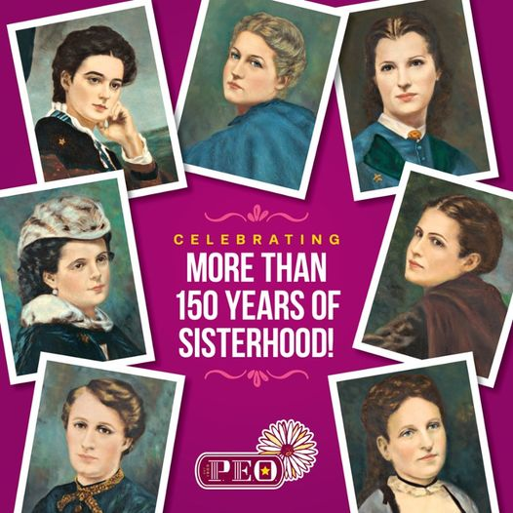

Slide 2
The Setting
These women were college students, attending Iowa Wesleyan in Mount Pleasant, in 1869. They were unusual in their religious and pioneer heritage, for all of their families were deeply religious people who made Christian ethics part of their everyday lives. These sturdy people had come to this community, known as "The Athens of Iowa" during the wave of mid-western expansion and had brought to it a desire for culture and intellect. These women shared a joy and awareness of their education as well as a realization of the changing status of women in the world.

Slide 3
The time was right for the creation of P.E.O. Movements formed by the industrial and mechanical revolutions, the Feminist Movement, western expansion, Civil War, the beginnings of the fraternity system, acceptance of education for women all caused an impact on the minds of these seven women. Their response was a desire to form a society of their own.

Slide 4
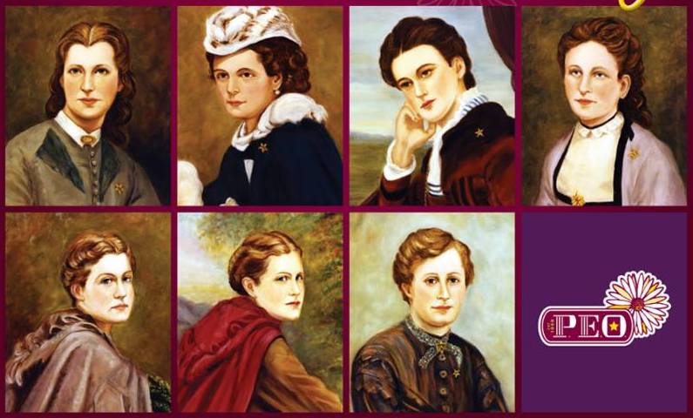
The Founders: Ella Stewart, Suela Pearson, Alice Bird, Hattie Briggs Alice Coffin, Franc Roads & Mary Allen

Slide 5
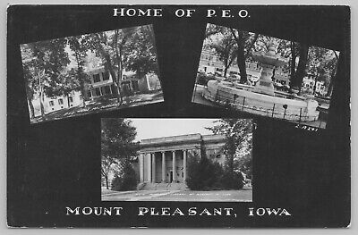
Birthplace of P.E.O
January 21, 1869
Ohio Wesleyan College
Mt. Pleasant Iowa

Slide 6
The Event
In 1869, a new woman's college fraternity I.C. Sorosis (later to be know as Pi Beta Phi) had just been formed at nearby Monmouth College, Illinois. A member from this fraternity at Monmouth transferred to Iowa Wesleyan. Her intent was to start a second chapter and six of the seven close friends were invited to join.
Hattie Briggs and Franc Roads gathered on the Iowa Wesleyan Campus and Hattie said “Let Us start an order of our own”
That afternoon Alice Bird wrote the 35 word oath (still embedded in today’s initiation ceremony). Ella read Alice Bird the oath. After accepting, Alice initiated the five others

Slide 7
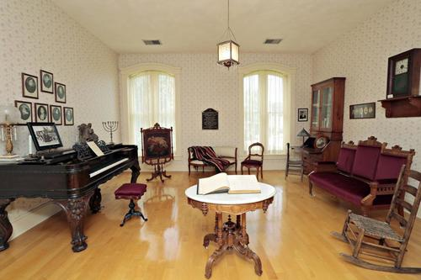
First Gathering
January 21, 1869 the seven founders gathered in secret in the Music Room of Main Hall to form their ’Secret Society”. They decided what sort of society they would form and the aims that would be. They announced their society by marching together into the assemble wearing identical aprons and gold stars in front of the IC sorority.

Slide 8
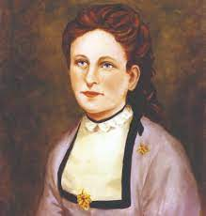
Hattie Briggs
The One Who Got The Idea
&
Gave Us Our Name:
P.E.O.

Slide 9
Hattie Briggs
Witty, Joyous Friendship, Enthusiasm for Living Kind Hearted
“Calm, Serene & Useful”
“The Best Hearted Girl That Ever Lived.
None Knew Her But To Love Her”

Slide 10
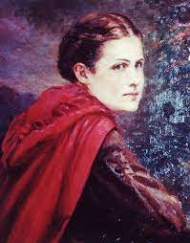
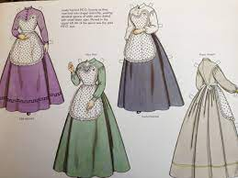
Franc Roads
Youngest Founder (14)
Designed the Aprons wore to assemble to announce their Sisterhood

Slide 11
Franc Roads
Energetic, Visionary, Ahead of her time
Faith in women’s destiny to shape the world
Interested in Women's rights
A Statesmen, an Artist, and a Teacher

Slide 12
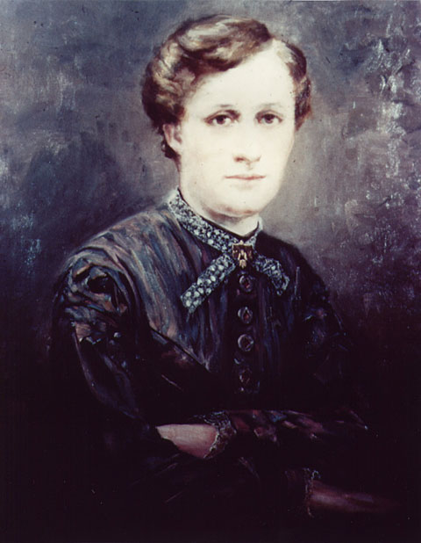
Mary Allen
Stressed the Importance of Proper Procedure in Conducting Business Meetings
“We are but undisciplined if we cannot endure the quiet restraint of listening”

Slide 13
Mary Allen
Poised and quiet,
“Wholesome and Gracious”
Delightful sense of Humor
Deep abiding faith in God, Held firm that Christianity is the practical solution to life's problems
Total concern for other people
Treasured her friends loves her fellow man

Slide 14
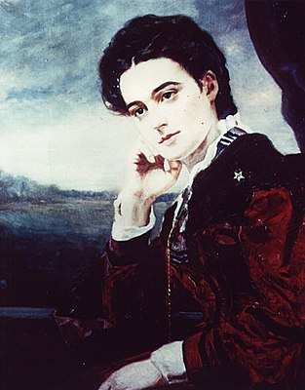
Alice Bird
Wrote the original Constitution & Composed the Original Oath
Wrote many of the Laws, Resolutions and Ceremonies
First P.E.O.President

Slide 15
Alice Bird
Brilliant Mind,
Knowledge of literature, Eloquent writer
Singer in College Quartet
“When any bold or daring adventure was incubating , Allie was there in the midst”

Slide 16
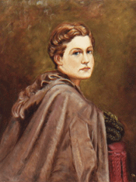
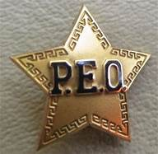
Alice Virginia Coffin
Suggested the Star
&
Designed the Emblem
The proper place is on the left shoulder. Touching the emblem can be used as a sign of distress or warning and if sister saw this she was to come to their aid at once.
Today it is to be worn over the heart and above all other emblematic badges.

Slide 17
Alice Virginia Coffin
Sparkling personality
Loved to dance & sing
Tact & Poise
Courage & Heart
“Like a Goddess, Stately and Dignified”

Slide 18
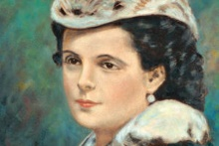
Suela Pearson
The First to Present the P.E.O. Tradition:
Which judges Only by the Soul and Character of the Bearer and NOT the Outward Signs of Age, Class or Circumstances.
Proposed the password

Slide 19
Suela Pearson
Gracious and Cultured with
Charm, Talent and Virtue
Adored by Everyone

Slide 20
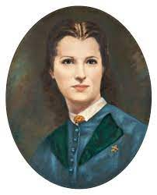

Ella Stewart
Chose The Colors

Slide 21
Ella Stewart
Devotion and Service to Others
“Vivacious, Interested in All Good Works and Ready to Do Them”

Slide 22
Changes
Nellie Ambler Campbell wrote an initiation ceremony which was adopted by Chapter A in January 1882.
Effie Hoffmann Rogers revised slightly and along with prayer for Initiation adopted in 1886
1907 soft music was permissible to play during initiation ceremony,
Reciting the Lords prayer as part of opening exercises was official in 1912
The Object & Aims became part of opening chapter meetings in 1930 with the last paragraph only allowed to be printed after 1977

Slide 23
Future
The founders never believed that their society would remain a campus organization.
Alice Bird (1872): “We desired something broad and substantial. We did not for one moment wish our organization to be a mere college fraternity, but a society of more lasting name and reputation. We knew our organization was going to endure for many generations to come and we wanted a strong foundation”
Franc Roads (1924): “I have an abiding faith in what women can do…I wonder if we realize the potential power which is possessed by an organization of35,000 women. Such tremendous powers, if properly directed and supported by its members would accomplish things of which we do not dream today”

Slide 24

Today
P.E.O. is found throughout all 50 states and Canada with over 230,000 members
P.E.O. has developed and maintained 5 projects: ELF, PCE, IPS, PSA, STAR and is the stewards of Cottey college
P.E.O. has helped over 119,000 women by providing over $398 million

Slide 25
P.E.O. Mission
P.E.O.’s mission is to celebrate the advancement of women; educate women through scholarships, grants, awards, loans and stewardship of Cottey College; and motivate women to achieve their highest aspiration.

