Slide 2
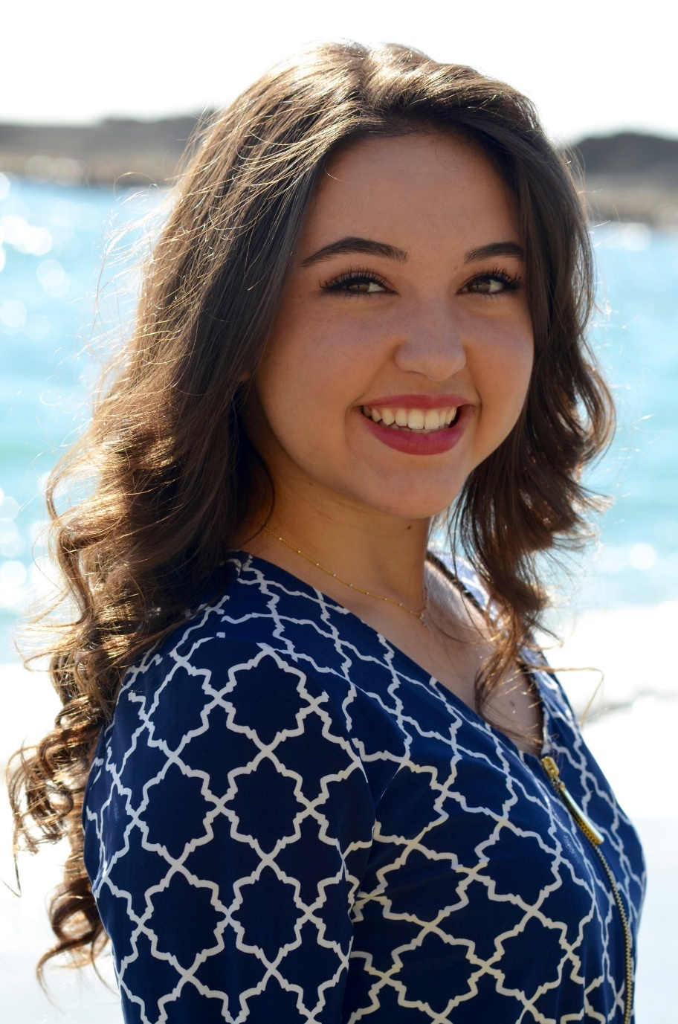
What is the P.E.O. STAR Scholarship?
$2,500 scholarship
Established in 2009
Provides scholarships for exceptional women in her final year of high school to attend an accredited postsecondary educational institution in the United States or Canada in the next academic year
Taryn Murphy, 2017 STAR Recipient

Slide 3
How does a chapter recommend a candidate?
First – FIND her! STARs are all around you.
Interview your candidate.
Determine if she has STAR qualities.
Chapter STAR committee makes its recommendation.
Chapter votes. A majority of members present is required.
Record date of vote in the chapter minutes and note it on the recommendation form.
Begin the application process. READ the information provided on the website at www.peointernational.org. Click P.E.O. Projects, then STAR.

Slide 4
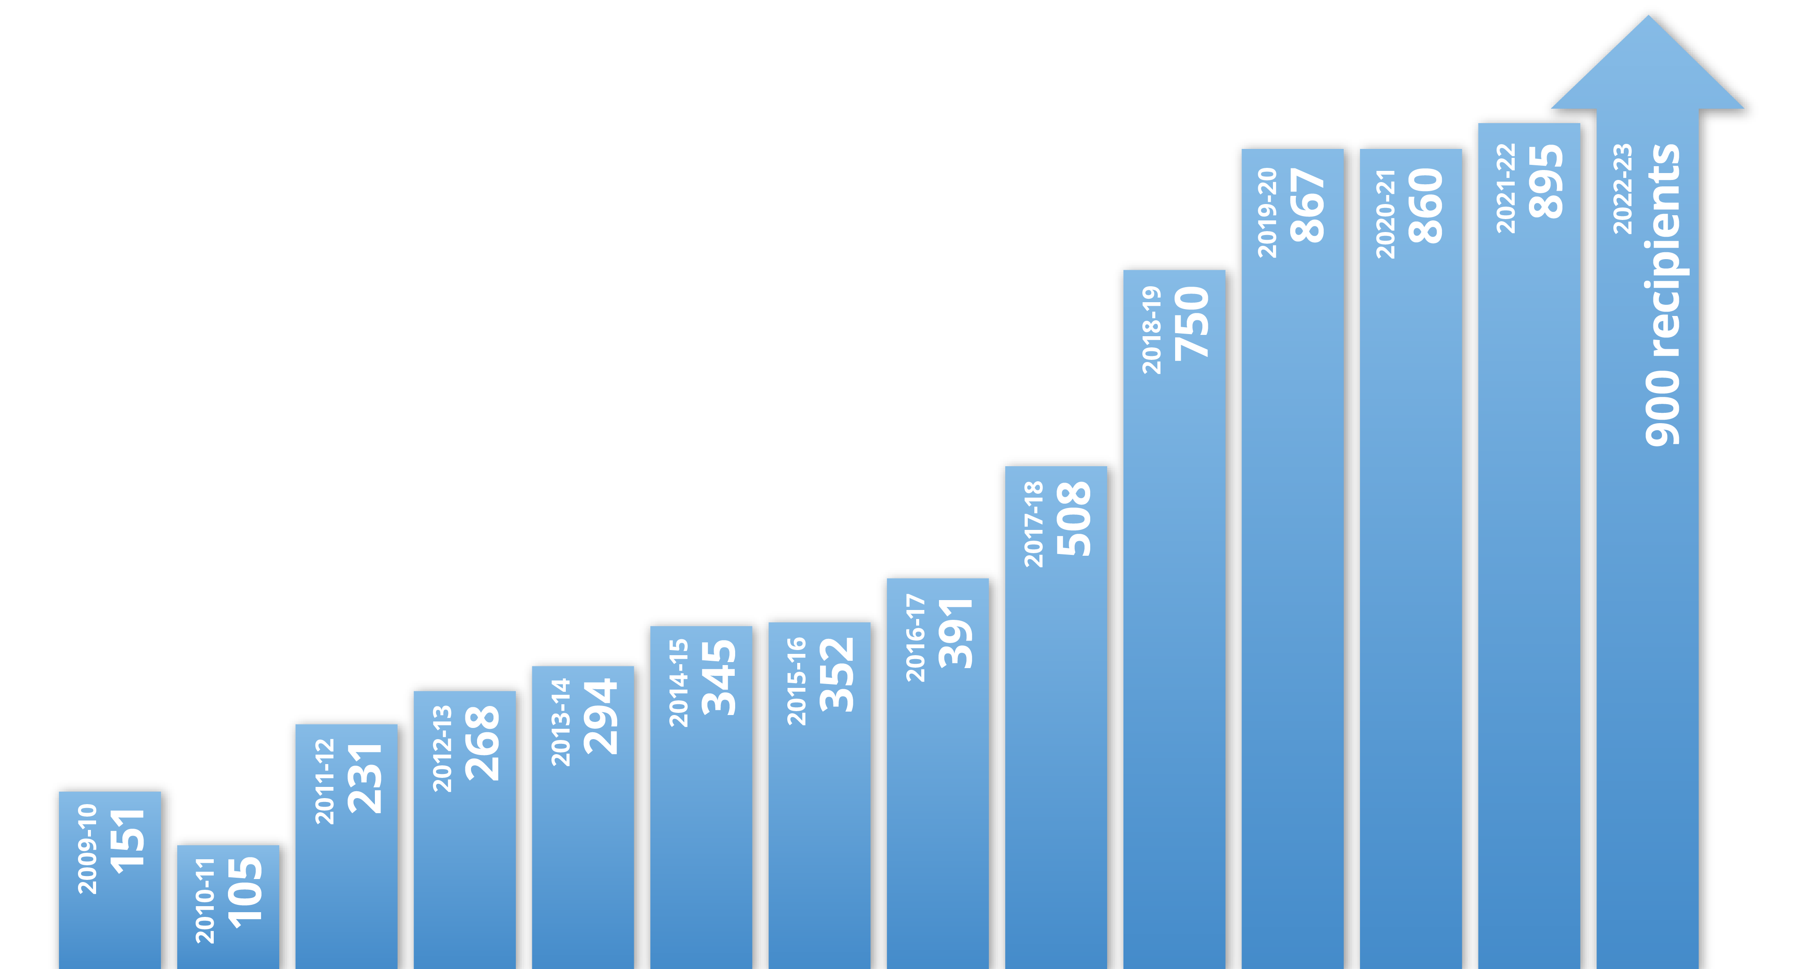
How many scholarships are awarded each year?
The P.E.O. Sisterhood has helped
6,917 students realize their dreams of entering college. That’s $17,223,000!
Thank you for your generous support!
Each STAR scholarship is $2,500.

Slide 5

How many high school senior girls apply each year?
Approximately 2,000 applications are received each year.
The STAR Trustees accomplish this reading in multiple rounds, providing a comprehensive review.

Slide 6

So, THAT’s why the deadlines are so strict?
YES! Extending deadlines creates a delay with the final determination of awards.
Awards are posted by April 30 each year so chapters can present the scholarships at honors assemblies.

Slide 7
DEADLINES!
Check the website each year to confirm the recommendation window.
Applicants have 30 days after receiving the link to complete their application.
Deadlines are at 11:59 p.m. Eastern Standard Time (EST) on the due date.

Slide 8
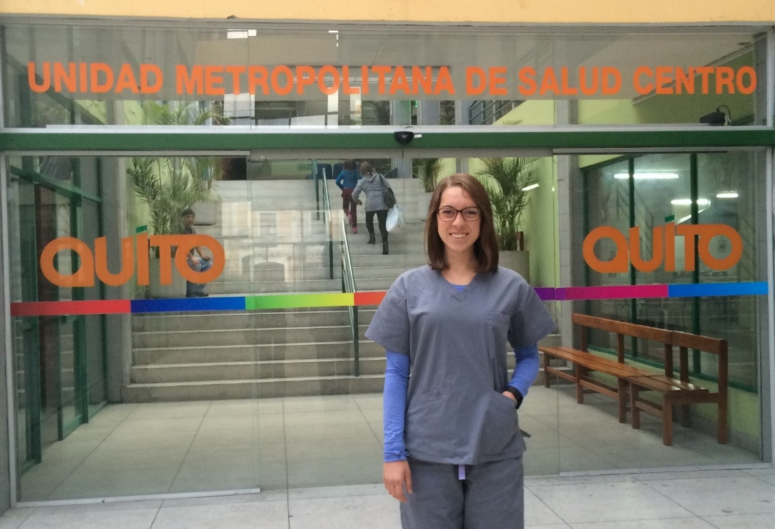
Who can be a STAR?
A young woman who…
Exhibits excellence in leadership, academics, extracurricular activities, community service and potential for future success
Is in the final academic year of her secondary education and is 20 years of age or under at the end of the calendar year
Has a minimum cumulative unweighted GPA of 3.0 on a 4.0 scale
Kate Sarfert, 2013 STAR Recipient

Slide 9
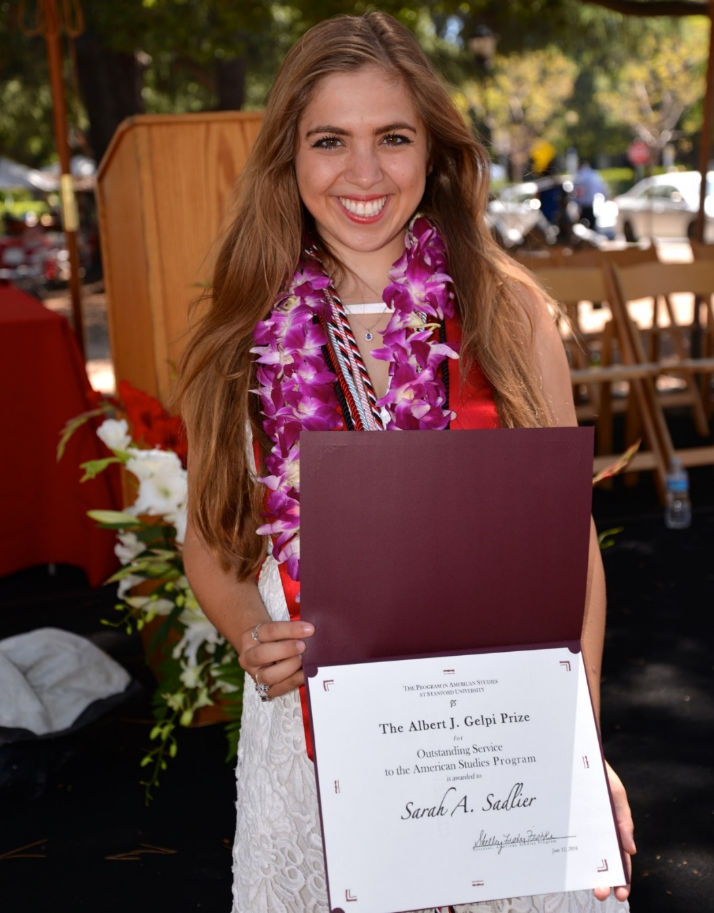
Who can be a STAR?
And also…
Is a citizen or legal permanent resident of the United States or Canada
Plans to attend an accredited postsecondary educational institution in the U.S. or Canada, full or part time, in the fall of the academic year following high school graduation
Is recommended by and receives the vote of a local P.E.O. chapter
Sarah Sadlier, 2012 STAR Recipient

Slide 10
Before you write your letter
GET TO KNOW YOUR POTENTIAL STAR
What are her interests and passions?
How is she involved in school, religious or cultural activities
and/or community?
What does she envision doing in 5 years? Ten years? Beyond?
What are her inspirations and motivations?

Slide 11
MORE IDEAS…
?
?
?
?
Is there any experience that has influenced her life?
What are her goals beyond high school?
How has her leadership impacted her school? Community?
What does she love to do?

Slide 12

Are you frustrated because none of the women you’ve recommended have received a STAR Scholarship?
Don’t give up! Follow the directions, read The P.E.O. Record and check the website for FAQs.
Remember, there is much more to a STAR than academics!
?

Slide 13

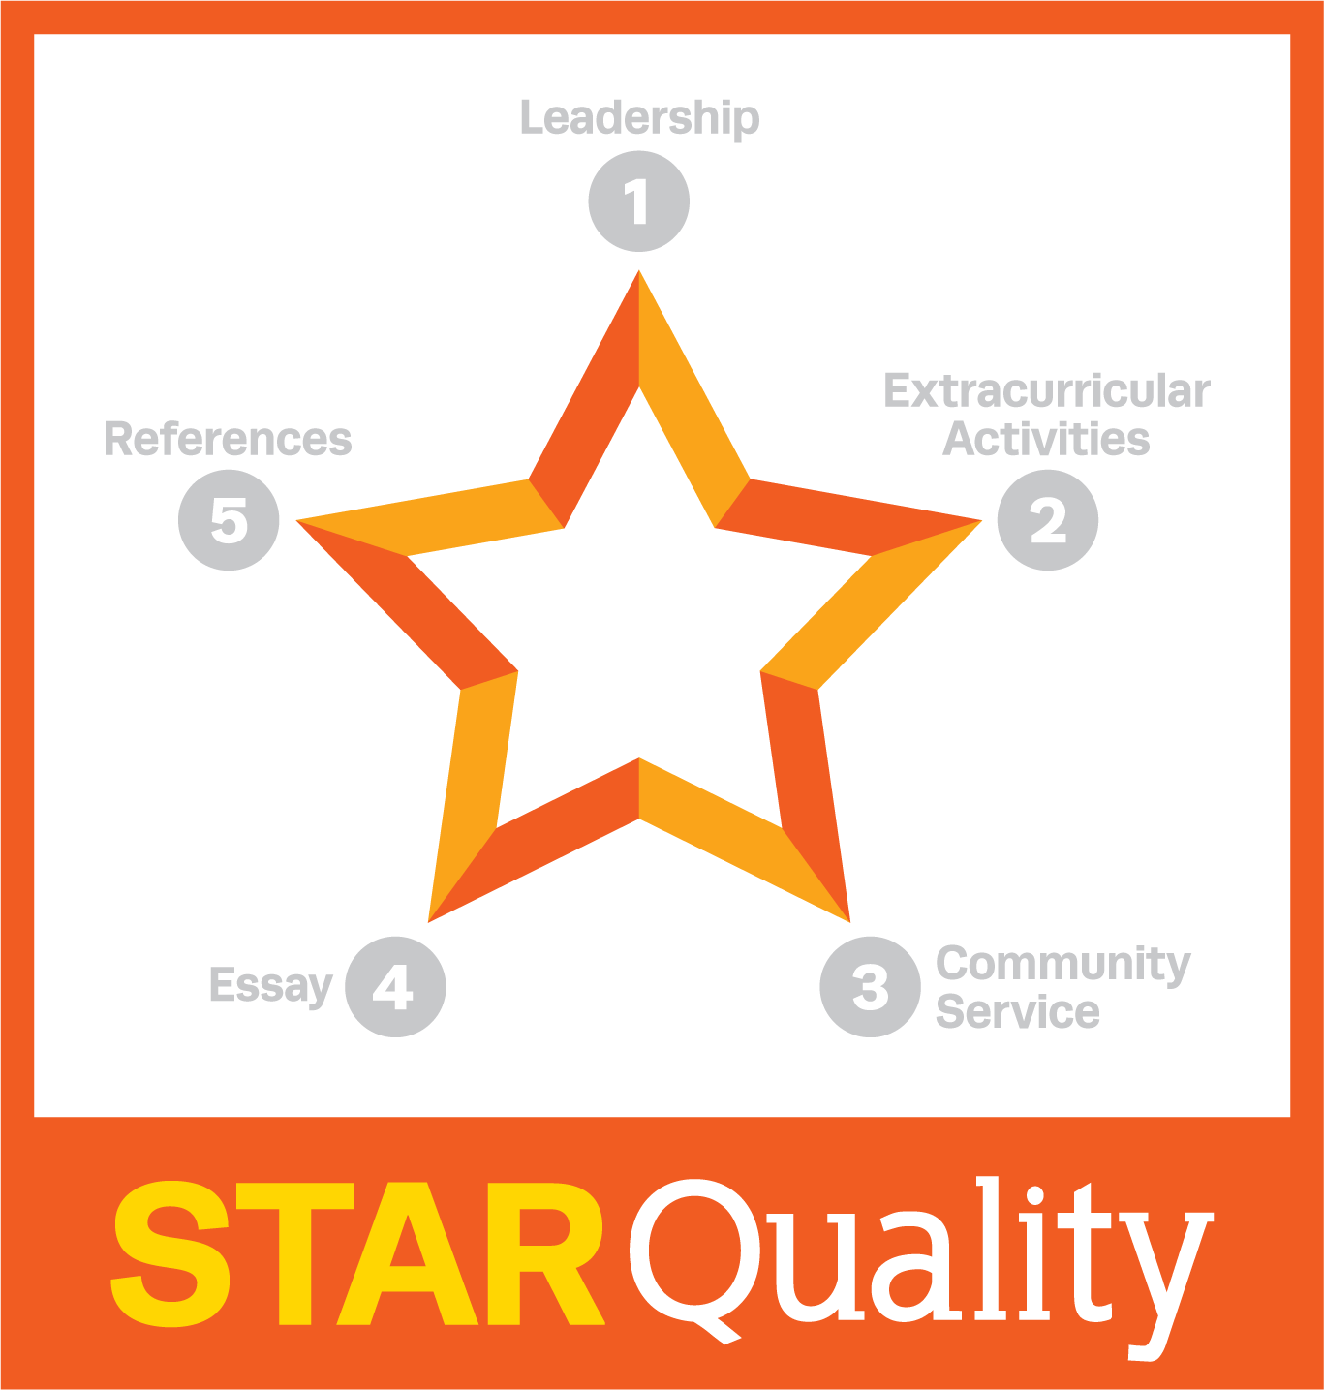
BUT… We’ve done all that. What else should we know?
Look to your left and start at the top with Leadership.
What formal leadership experience is evident? Remember that leadership takes many forms, but documentation is critical.
What has your candidate proactively done to serve as a model for others?
Leadership

Slide 14

OK… Got it! What else?
Extracurricular activities offer a glimpse of your candidate’s interests and even passions.
Extracurriculars noted must traverse at least two years. Again, documentation is critical.
What does your candidate enjoy and pursue over time?
Extracurricular Activities

Slide 15

OK… Got it! What else?
Community service also offers a glimpse of your candidate’s interests and passions.
Encourage your candidate to state her volunteer hours but also indicate service to family above the norm, such as a caregiver.
How does your candidate contribute to society?
Community Service

Slide 16

We understand she writes an essay?
Your candidate’s essay further offers a glimpse into her interests, passions and dreams for the future.
Encourage her to share something about herself, including what drives her hopes and dreams.
How does she envision herself in the future – even beyond college?
Essay

Slide 17

Are the references really important?
Absolutely! Your candidate’s references allow valuable views from other perspectives.
The references must convey the real person in a manner that “lifts her off the page.”
References also should market the candidate and convey her likelihood for future success.
References

Slide 18
Our candidate was valedictorian.
How could she not have received an award?
Think back…
  All that is needed academically is a “B” average, or unweighted 3.0/4.0.
  Many STAR Scholars are not the highest academic achievers, but they excel in all the other areas.
  Do not exclude a potential candidate because she does not carry an over-the-top GPA. She may be a true STAR!

Slide 19
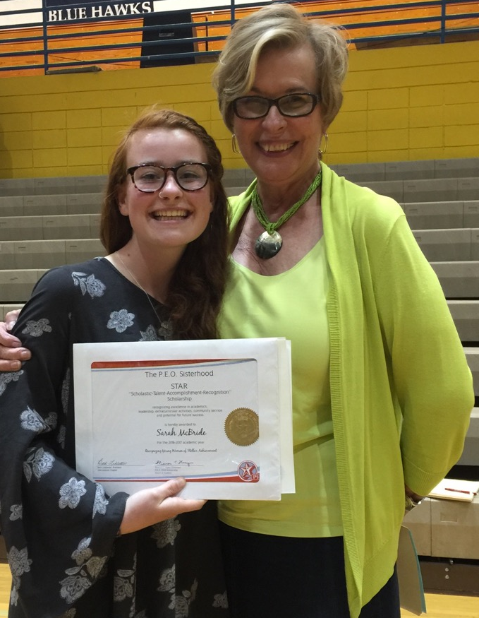
I hear that to be a STAR Scholar, a candidate must be working on a cure for cancer or be out saving the world!
Not quite, although our STARS do have purposeful lives! This young lady saw a need for a recycling program at her school. A passionate conservationist, she also is an athlete, writer and active community volunteer.
Watch The P.E.O. Record and social media for other fascinating stories.
Sarah McBride, 2016 STAR Recipient

Slide 20
Have you considered telling her about Cottey?
What about inviting her to become a member?
1.
Might your
candidate
be interested
in attending
Cottey College?
2.
Would she
someday make
a wonderful
member of
your chapter?
3.
Have you
promoted other
P.E.O. projects?
(ELF may be a good
fit in a few years.)

Slide 21

What else can a chapter do?
P.E.O. Named STAR Scholarship
Contribute a lump sum of $2,500 in one fiscal year to name a STAR in memory or in honor of someone dear to you or your chapter.
Emily Wood, 2017 Mary Reams
Named STAR Scholar

Slide 22
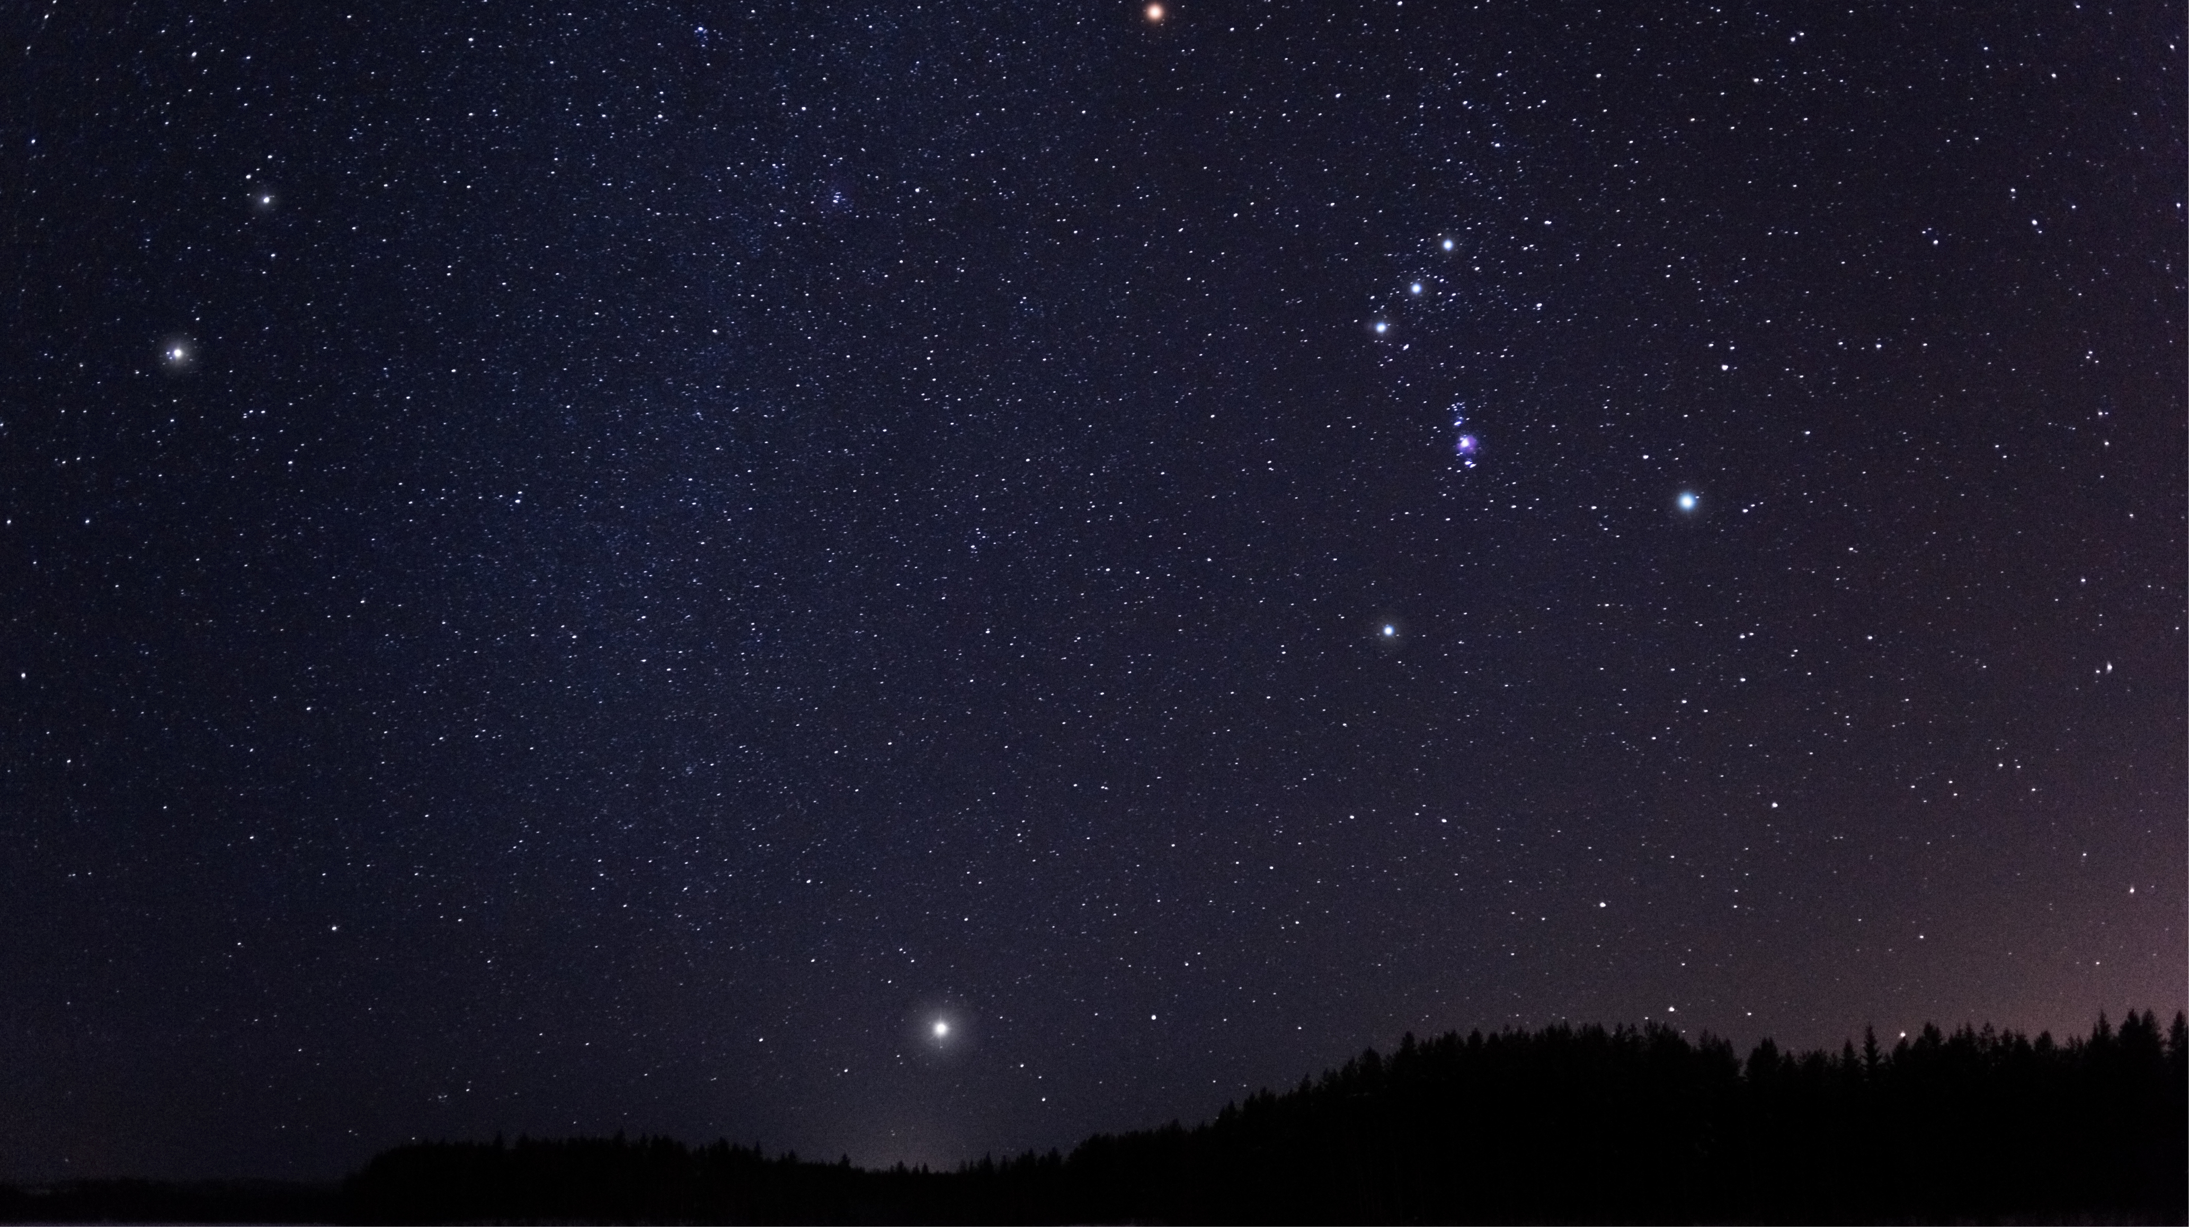

P.E.O. STAR Scholarship
Constellation Chapter Designation
Become a Constellation Chapter with your chapter’s lump sum gift of $500
Consult the P.E.O. STAR Scholarship page at https://members.peointernational.org/constellation for Constellation Chapter information.

Slide 23

And, also remember…
P.E.O. Endowed STAR Scholarship
Establish an ongoing fund in the Foundation in memory or in honor of someone dear to you or your chapter.

Slide 24
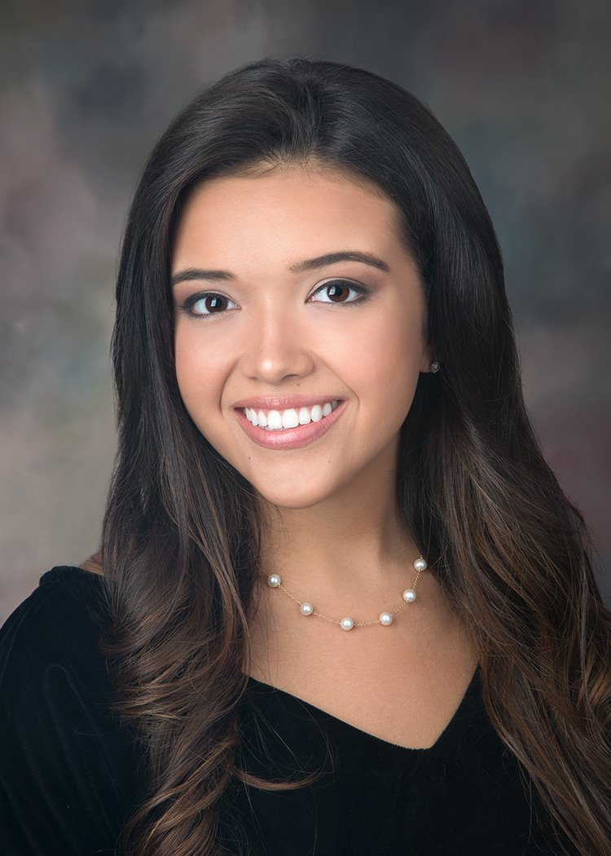
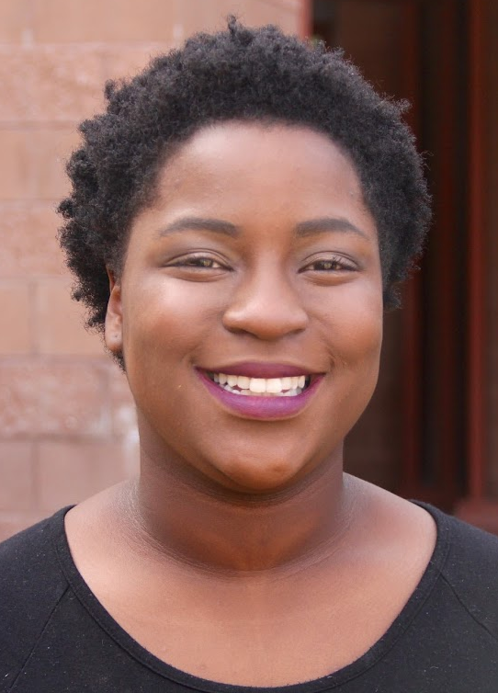
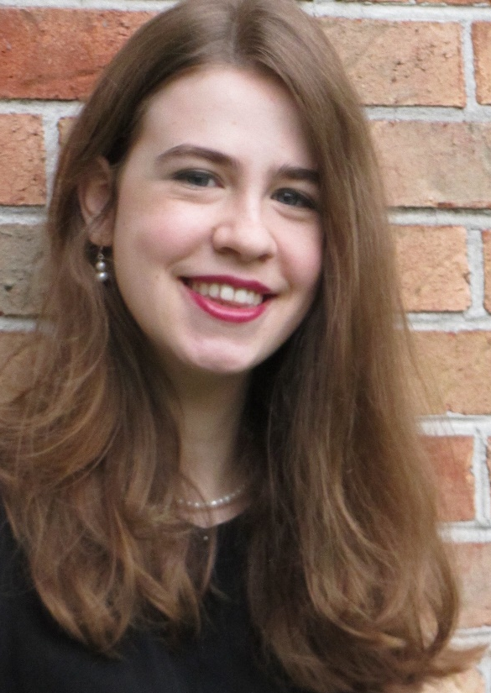
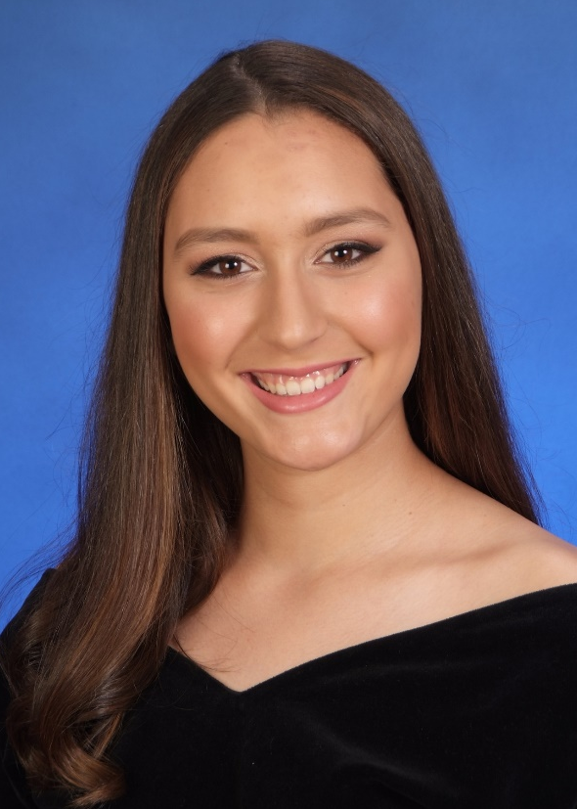
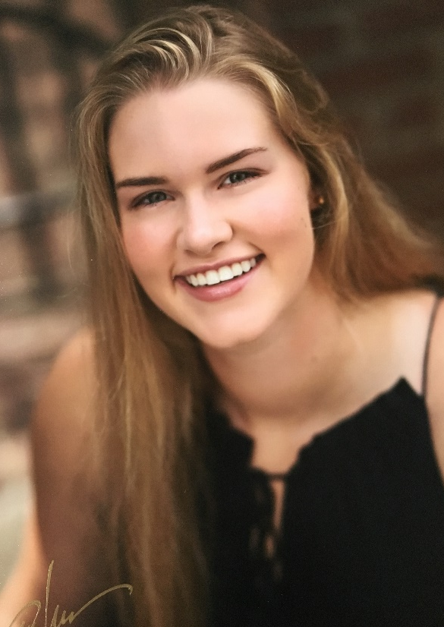
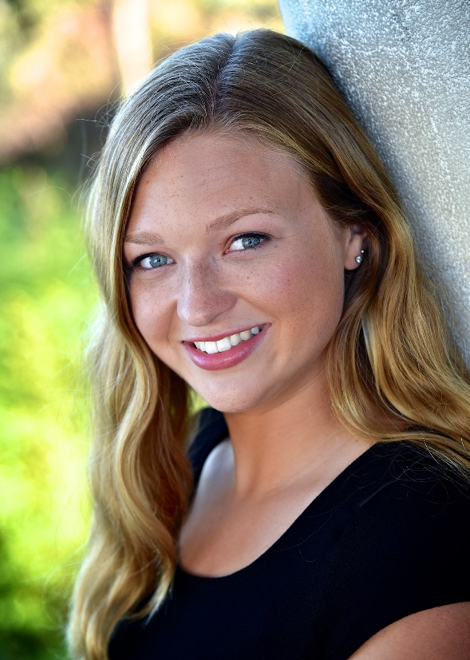

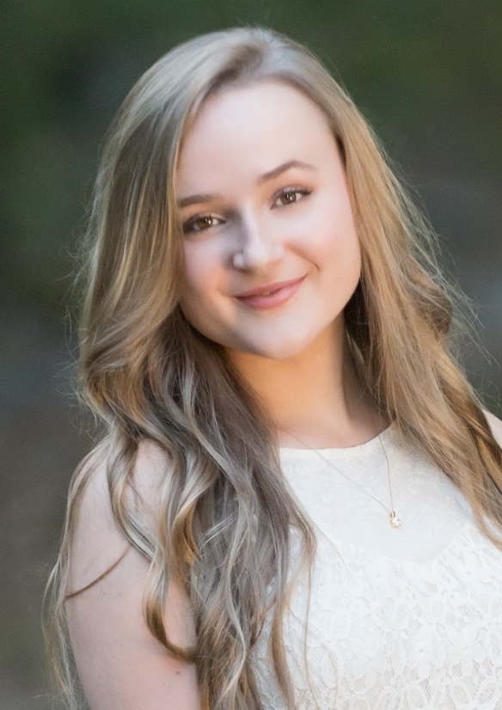

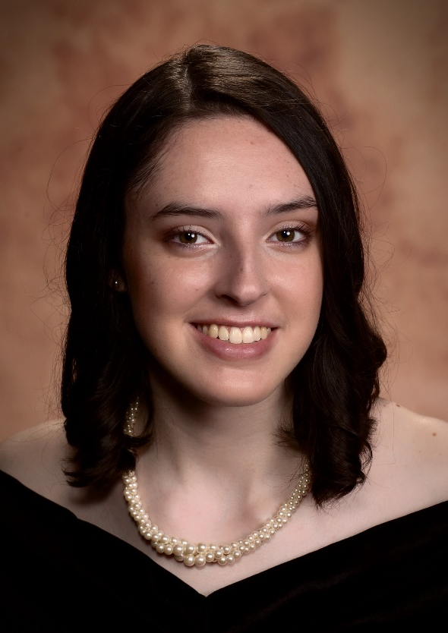
“The P.E.O. STAR Scholarship has served as a reminder to me that I do not stand alone in my passion and that there are other women who also want to show their strength and to help make the world a better place.”
Erica Brenner
2017-2018 STAR Scholarship Recipient

Slide 25

P.E.O. STAR Scholarship
Recognizing young women of STELLAR Achievement!
Thank you for your…
  STAR interest
  STAR enthusiasm
  STAR inquiry
  STAR energy
And especially…
  Your STAR SUPPORT!

