Slide 1


GA P.E.O Town Hall
Agenda: STAR and PSA
International Projects Committee (IPC)
September 17, 2024

Slide 2



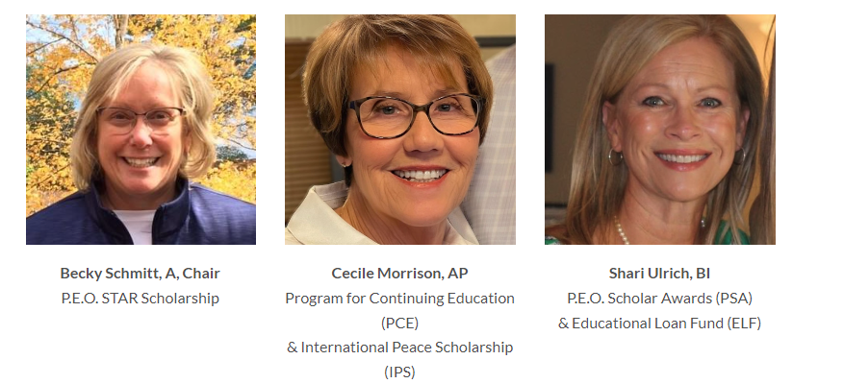


What is the International Projects Committee?
The 3-member IPC:
Works with chapters to find sponsors for potential project candidates that express interest on the P.E.O. website
Assists local chapter members with any questions or issues regarding the 5 International P.E.O. Projects (note Cottey and GA scholarship have separate committees)
Collects data from International and reports at the GA State Convention
Contact us at peogaintprojects@gmail.com

Slide 3
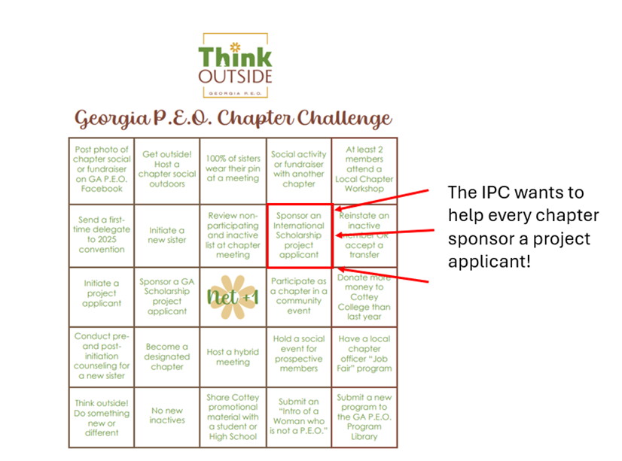
What is the International Projects Committee?

Slide 4


STAR Program Recap
A one-time $2,500 scholarship available to exceptional women in their final year of high school to attend an accredited post secondary educational institution in the next academic year.
Applicants for the P.E.O. STAR Scholarship are evaluated on demonstrated excellence in the areas of leadership, academics, extracurricular activities, community/volunteer service and potential for future success. An applicant selected as a STAR Scholarship recipient will have shown excellence in all five areas.

Slide 5
STAR Program Recap
Chapter recommendation is required, which includes a local chapter approval vote. The recommendation window is August 15 – October 15 (11:59pm EST).
Student must have a minimum cumulative unweighted GPA of 3.0 on a 4.0 scale.
Chapter may submit only ONE candidate per academic year.
Student must be 20 years of age or younger at the end of the calendar year in which she applies.
All parts of the application are submitted online.
Student’s portion of the online application must be submitted no later than 30 calendar days after she has received a link with instructions to set up her online account.
Scholarship recipients are announced to the individual and the sponsoring chapter by April 30.
Again in 2024, all successful STAR applicants will be offered direct admission to Cottey College and an academic scholarship. Acceptance of this offer does not impact the decision as to whether a student receives a STAR Scholarship.

Slide 6
STAR Statistics
Established in 2009
Through April, 2024, 8,794 scholarships have been awarded for a total of $21.8 million
STAR scholarship is very competitive
The number of scholarships awarded each year is determined by the funds raised
For the 2023/2024 academic year, there were 1,000 scholarships granted from 2,186 applications (c. 46%). For Georgia, there were 22 scholarships from 35 applications.
Stats for the 2024/2025 academic year are not yet available, however GA successfully submitted 39 applications.

Slide 7
STAR Helpful Hints
Chapter recommendation is very important – make your candidate shine!
Get to know your candidate so you can be a strong advocate. For example, what makes her a good leader, how has she influenced others, how is she poised for future success, what are her passions, what’s a challenge she has overcome? Highlight examples of how her Extracurricular Activities or Community Service have helped her make a difference or prepared her to be a leader.
Don’t repeat information that included in the application. The size of the recommendation is limited, so use every word to show how your candidate is deserving of the scholarship. The recommendation questions are:
Regarding your applicant’s extracurricular activities, how has she made a positive impact on her school and/or community?
Regarding your applicant’s community service experiences, how has she made a positive impact on her school and/or community?
Specify the leadership qualities that you believe will carry her successfully into the future.
What do you admire most about your applicant? How does this add to her STAR Quality?
Is there anything else you would like to say about your applicant?

Slide 8
STAR Helpful Hints
Candidates may have more Extracurricular Activities, Community Service or Awards/ Honors than space allows. Work with the candidate to ensure she includes the ones most meaningful to the award criteria.
Help your candidate highlight her accomplishments so she stands out.
Offer to review the candidate’s essay before submission. The committee is looking for submissions that are well-written, organized and follow the essay guidance. Submitting an essay used for another application may not address the STAR qualities which will not be viewed favorably.
Closely coordinate the timing of your recommendation submission with your candidate
Don’t wait until the last minute in case you encounter any technical difficulties
Candidate will receive a link upon your recommendation submission and has 30 days to submit their application. This includes her essay and both references, so ensure she is ready to meet that deadline, including having her references ready to respond quickly.

Slide 9
STAR Helpful Hints
Help the candidate identify references that will help her stand out from other applicants
Two references must accompany the application
References should know the candidate well and be willing to take time to portray her in the best way
In what capacity and for how long have you known this student?
Describe her strengths and challenges based on your personal observations. How has she made a positive impact on her school and/or community?
Specify qualities of character and skill sets that you believe will carry her successfully into the future.
If you were to choose one aspect of this young woman that you and/or others around her admire most, what would that be? Why does this aspect of the applicant make her exceptional?
Is there anything else you would like to say about this young woman?

Slide 10
PSA Program Recap
A one-time merit-based scholarship available to women pursuing a doctoral-level degree at an accredited college or university. The maximum award is $25,000. This award is designed for women who are excelling in their fields and have clearly articulated visions for the future impact of their work.
Chapter nomination is required, which includes a local chapter approval vote. The chapter nomination period is August 20 - November 20 (11:59pm EST). Recipients are notified May 1. The first half of the payment is sent August 1. The second half is sent January 31.
Student must have completed at least a bachelor’s degree, must be within 2 years of graduation and have at least 1 full academic year of work remaining to complete her doctoral-level degree measured from August 1 when the first payment is made.
Study abroad is permitted if enrolled in an accredited US or Canadian school.
A woman is NOT eligible for a MS degree, certificate, residency, fellowship, specialization, or postdoc.
Chapters may nominate more than one candidate and the candidate does not need to reside in the state where the chapter is located.
Nominees must complete their application within 45 days of receiving the application link from P.E.O. International.

Slide 11
PSA Statistics
Established in 1991
Through April, 2024, 2,935 scholarships have been awarded for a total of $36.7 million dollars
PSA scholarship is very competitive
There were 97 scholarships awarded for the 2024/2025 academic year
GA chapters nominated 37 applicants, of which 3 were awarded scholarships

Slide 12
PSA Helpful Hints
Writing a great nomination letter for your candidate:
Use words to make your candidate stand out, such as Amazing! Brilliant! Accomplished! Her application will show that she possesses these qualities, and she, herself will provide evidence of her qualifications.
Her professor(s) and her university representative will describe her area of research/study, as well as supporting details of her accomplishments thus far.
The nomination letter will explain why your chapter has chosen to sponsor this woman.
Does someone in your chapter personally know her, and if so, for how long and in what capacity did you first meet her?
During your interview with her, (whether in person or via Zoom) she will have left an impression on you; hopefully a positive one, otherwise you wouldn’t be submitting her name! What about her strikes you regarding her ability to make an impact in her field? What makes you feel excited about sponsoring her?

Slide 13
PSA Helpful Hints
Writing a great nomination letter (continued)
Provide information that isn’t found in any other application document. For example, the titles of all her publications or presentations, her GPA and academic awards will be listed by the applicant herself. Instead, focus elsewhere:
Has she shared her research with your chapter in a program?
Has she talked about her goals in research, and what she hopes to accomplish?
What is significant about how her work can affect our world in the future? Stress the value of her research, why she is outstanding and the impact she will have on the future through the field she is studying; present a well-rounded candidate.
Make your letter as personal as possible and reveal the woman behind her achievements.
Be concise as you have 200-300 words. Talk about why you and your chapter support this candidate and about her as a real person.

Slide 14
PSA Helpful Hints
It is often better for an applicant to apply further into the doctoral program as she will have achieved a more thorough picture of her work.
An unsuccessful candidate can be nominated again as long as she is within the timeframe. She would be presented as a new nomination and the nomination letter and application would be updated to include any new qualifications and accomplishments.
You may also may want to recommend that she apply for a loan through our Educational Loan Fund. The maximum ELF loan for doctoral degrees is $25,000 with a 2% interest rate.
While nominations may be submitted beginning August 20, there is no advantage in early submission. Coordinate the timing with your candidate, as your nomination triggers the 45 day timeline for her to complete the application. Reach out to her during this time to cheer her on and check on completion of the application.
There are resources available on the international website. Questions by nominees with regard to the process should be directed to the P.E.O. Scholar Awards office at (515) 255-3153 or psa@peodsm.org Chandra Bisgard; she will respond quickly as she knows all the answers!

Slide 15


Slide 16

FOR JOINING
Contact us with any questions at peogaintprojects@gmail.com

